Slide 1


Chapter 11
The Basics of Capital Budgeting
Brigham & Houston, Fundamentals of Financial Management, Sixteenth Edition. © 2022 Cengage. All Rights Reserved. May not be scanned, copied or duplicated, or posted to a publicly accessible website, in whole or in part.

Slide 2
Overview
Net Present Value (NPV)
Internal Rate of Return (IRR)
Modified Internal Rate of Return (MIRR)
Payback Methods: Regular vs. Discounted
Multiple IRRs

Slide 3
What is capital budgeting?
Analysis of potential additions to fixed assets.
Long-term decisions; involve large expenditures.
Very important to firm’s future.

Slide 4
Steps to Capital Budgeting
Estimate CFs (inflows & outflows).
Assess riskiness of CFs.
Determine the appropriate cost of capital.
Find NPV and/or IRR.
Accept if NPV > 0 and/or IRR > WACC.

Slide 5
What is the difference between independent and mutually exclusive projects?
Independent projects: If the cash flows of one are unaffected by the acceptance of the other.
Mutually exclusive projects: If the cash flows of one can be adversely impacted by the acceptance of the other.

Slide 6
What is the difference between normal and nonnormal cash flow streams?
Normal cash flow stream: Cost (negative CF) followed by a series of positive cash inflows. One change of signs.
Nonnormal cash flow stream: Two or more changes of signs.
Most common: Cost (negative CF), then string of positive CFs, then cost to close project. Examples include nuclear power plant, strip mine, etc.

Slide 7
Net Present Value (NPV)
Sum of the PVs of all cash inflows and outflows of a project:

Slide 8
Example
Projects we’ll examine:
Cash Flow
YEAR | L | S | ΔCF
0 | −100 | −100 | 0
1 | 10 | 70 | −60
2 | 60 | 50 | 10
3 | 80 | 20 | 60
ΔCF is the difference between CF_{L} and CF_{S}. We’ll use ΔCF later.

Slide 9
What is Project L’s NPV?
WACC = 10%
Year | CF_{t} | PV of CF
0 | −100 | −$100.00
1 | 10 | 9.09
2 | 60 | 49.59
3 | 80 | 60.11
 |  | NPV_{L} = $ 18.79
Excel: =NPV(rate,CF₁:CF_{n}) + CF₀
Here, CF₀ is negative.

Slide 10
What is Project S’ NPV?
WACC = 10%
Year | CF_{t} | PV of CF_{t}
0 | −100 | −$100.00
1 | 70 | 63.64
2 | 50 | 41.32
3 | 20 | 15.02
 |  | NPV_{S} = $ 19.98
Excel: =NPV(rate,CF₁:CF_{n}) + CF₀
Here, CF₀ is negative.

Slide 11
Solving for NPV: Financial Calculator Solution
Enter CFs into the calculator’s CFLO register.
  CF₀ = −100
  CF₁ = 10
  CF₂ = 60
  CF₃ = 80
Enter I/YR = 10, press NPV button to get NPV_{L} = $18.78.

Slide 12
Rationale for the NPV Method
NPV = PV of inflows – Cost
= Net gain in wealth
If projects are independent, accept if the project NPV > 0.
If projects are mutually exclusive, accept project with the highest positive NPV, one that adds the most value.
In this example, accept S if mutually exclusive (NPV_{S} > NPV_{L}), and accept both if independent.

Slide 13
Internal Rate of Return (IRR)
Solving for IRR with a financial calculator:
Enter CFs in CFLO register.
  Press IRR; IRR_{L} = 18.13% and IRR_{S} = 23.56%.
  Solving for IRR with Excel:
  =IRR(CF₀:CF_{n},guess for rate)

Slide 14
How is a project’s IRR similar to a bond’s YTM?
They are the same thing.
Think of a bond as a project. The YTM on the bond would be the IRR of the “bond” project.
EXAMPLE: Suppose a 10-year bond with a 9% annual coupon and $1,000 par value sells for $1,134.20.
  Solve for IRR = YTM = 7.08%, the annual return for this project/bond.

Slide 15
Rationale for the IRR Method
If IRR > WACC, the project’s return exceeds its costs and there is some return left over to boost stockholders’ returns.
If IRR > WACC, accept project.
If IRR < WACC, reject project.
If projects are independent, accept both projects, as both IRR > WACC = 10%.
If projects are mutually exclusive, accept S, because IRR_{s} > IRR_{L}.

Slide 16
NPV Profiles
A graphical representation of project NPVs at various different costs of capital.
WACC | NPV_{L} | NPV_{S}
0 | $50 | $40
5 | 33 | 29
10 | 19 | 20
15 | 7 | 12
20 | (4) | 5

Slide 17
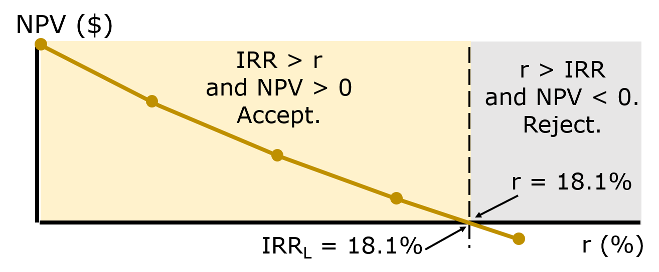
Independent Projects
NPV and IRR always lead to the same accept/reject decision for any given independent project.

Slide 18
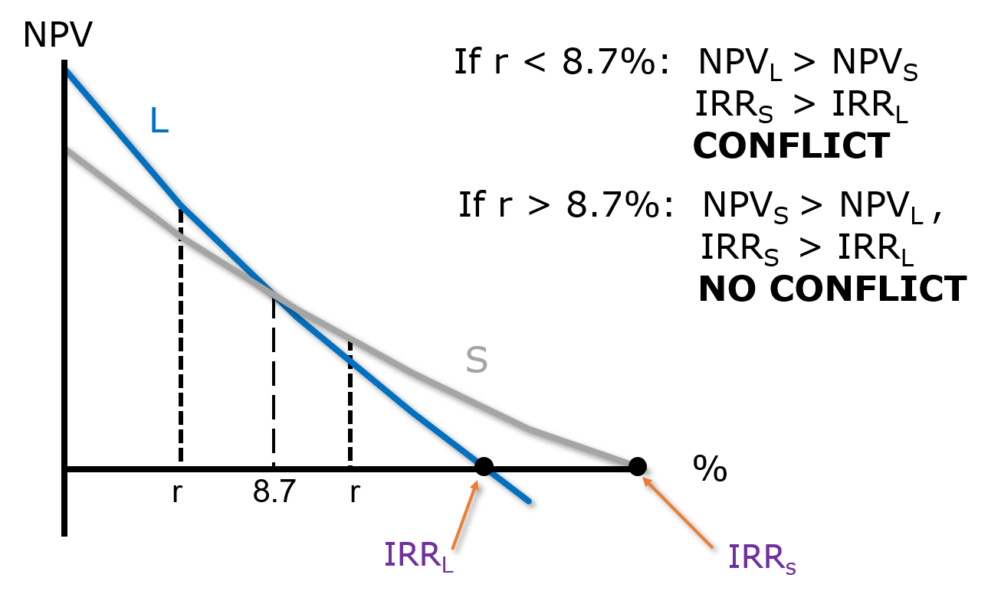
Mutually Exclusive Projects

Slide 19
Finding the Crossover Rate
Find cash flow differences between the projects. See Slide 11-8.
Enter the ΔCFs in CF_{j} register, then press  IRR. Crossover rate = 8.68%, rounded to 8.7%.
If profiles don’t cross, one project dominates the other.

Slide 20
Reasons Why NPV Profiles Cross
Size (scale) differences: The smaller project frees up funds at t = 0 for investment. The higher the opportunity cost, the more valuable these funds, so a high WACC favors small projects.
Timing differences: The project with faster payback provides more CF in early years for reinvestment. If WACC is high, early CF especially good, NPV_{S} > NPV_{L}.

Slide 21
Reinvestment Rate Assumptions
NPV method assumes CFs are reinvested at the WACC.
IRR method assumes CFs are reinvested at IRR.
Assuming CFs are reinvested at the opportunity cost of capital is more realistic, so NPV method is the best. NPV method should be used to choose between mutually exclusive projects.
Perhaps a hybrid of the IRR that assumes cost of capital reinvestment is needed.

Slide 22
Managers prefer the IRR to the NPV method; is there a better IRR measure?
Yes, MIRR is the discount rate that causes the PV of a project’s terminal value (TV) to equal the PV of costs. TV is found by compounding inflows at WACC.
MIRR assumes cash flows are reinvested at the WACC.

Slide 23
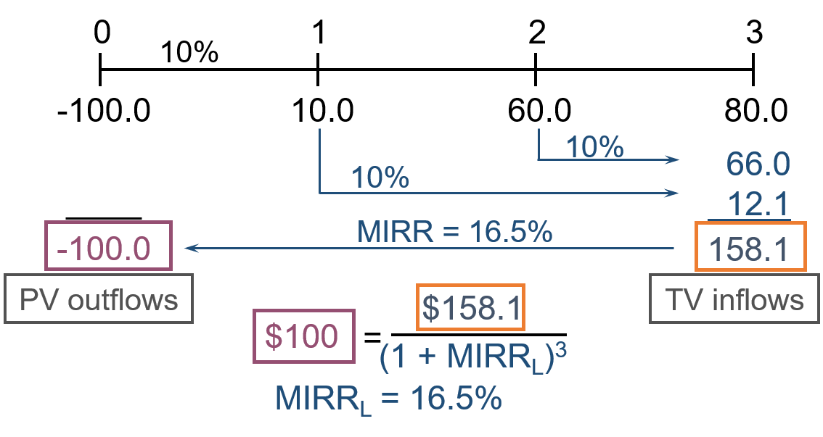
Calculating MIRR
Excel: MIRR(CF₀:CF_{n},Finance_rate,Reinvest_rate)
We assume that both rates = WACC.

Slide 24
Why use MIRR versus IRR?
MIRR assumes reinvestment at the opportunity cost = WACC. MIRR also avoids the multiple IRR problem.
Managers like rate of return comparisons, and MIRR is better for this than IRR.

Slide 25
What is the payback period?
The number of years required to recover a project’s cost, or “How long does it take to get our money back?”
Calculated by adding project’s cash inflows to its cost until the cumulative cash flow for the project turns positive.

Slide 26
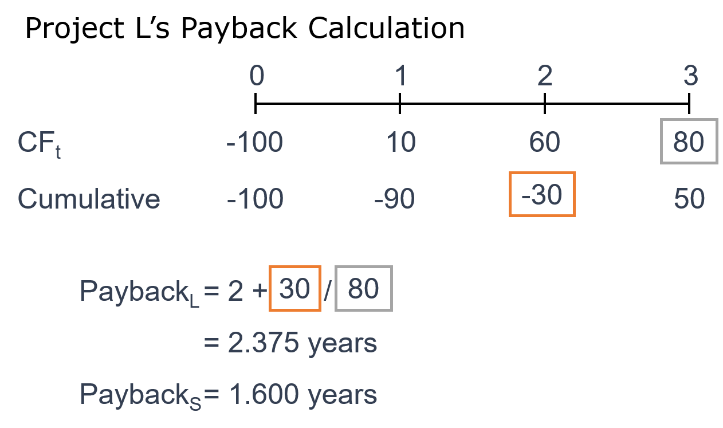
Calculating Payback
Project L’s Payback Calculation

Slide 27
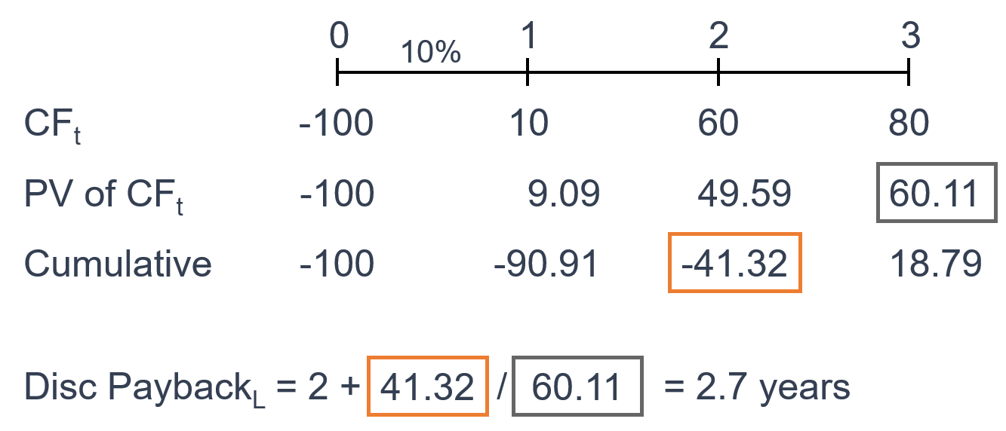
Discounted Payback Period
Uses discounted cash flows rather than raw CFs.

Slide 28
Strengths and Weaknesses of Payback
Strengths
  Provides an indication of a project’s risk and liquidity.
  Easy to calculate and understand.
Weaknesses
  Ignores the time value of money (TVM).
  Ignores CFs occurring after the payback period.
  No relationship between a given payback and investor wealth maximization.
Discounted payback considers TVM, but other 2 flaws remain.

Slide 29
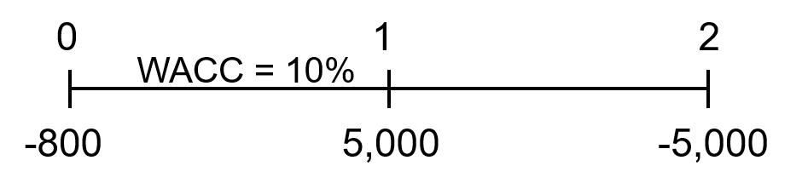
Find Project P’s NPV and IRR
Project P has cash flows (in 000s): CF₀ = -$800, CF₁ = $5,000, and CF₂ = −$5,000.
Enter CFs into calculator CFLO register.
Enter I/YR = 10.
NPV = -$386.78.
IRR = ERROR Why?

Slide 30
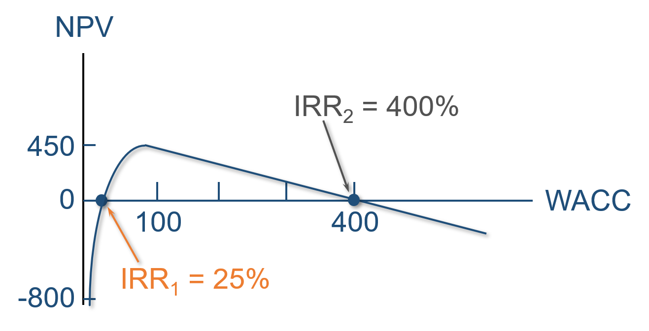
Multiple IRRs

Slide 31
Why are there multiple IRRs?
At very low discount rates, the PV of CF₂ is large and negative, so NPV < 0.
At very high discount rates, the PV of both CF₁ and CF₂ are low, so CF₀ dominates and again NPV < 0.
In between, the discount rate hits CF₂ harder than CF₁, so NPV > 0.
Result: 2 IRRs.

Slide 32
When to use the MIRR instead of the IRR? Accept Project P?
When there are nonnormal CFs and more than one IRR, use MIRR.
  PV of outflows @ 10% = -$4,932.2314.
  TV of inflows @ 10% = $5,500.
  MIRR = 5.6%.
Do not accept Project P.
  NPV = -$386.78 < 0.
  MIRR = 5.6% < WACC = 10%.

