Slide 1
Chapter 1
An Overview of Financial Management
Brigham & Houston, Fundamentals of Financial Management, Sixteenth Edition. © 2022 Cengage. All Rights Reserved. May not be scanned, copied or duplicated, or posted to a publicly accessible website, in whole or in part.

Slide 2
An Overview of Financial Management
Forms of Business Organization
Creating Value for Investors
Stockholder-Manager Conflicts
Stockholder-Debtholder Conflicts
Balancing Interests of Shareholders and Society
Notes:
Free Enterprise – Maximize Share holder Value.
Old model – Still the best model – Need to recognize all costs (modern spin)
Definitions – Cool but not good material for a test. Hard to be precise … lot of overlap.
Focus more on Concepts.

Slide 3
Finance Within the Organization
Notes:
Sarbanes-Oxley – CEO and CFO must certify that financials are accurate. (to SEC)
CEO often Chairman of board
COO often president

Slide 4
Forms of Business Organization
Proprietorship/ Partnership
Corporations
LLC
LLP
S Corp
Notes:
Proprietorships are most common form of business. But Corporations account for 80% of total value.
LLC LLP Votes in proportion to share, unlike limited partnership = General partner has control

Slide 5
Proprietorships and Partnerships
Advantages
No corporate income taxes
Ease of formation
Subject to few regulations
Disadvantages
Unlimited liability
Limited life
Difficult to raise capital
Often set up through LLCs/LLPs.

Slide 6
Corporation
Advantages | Disadvantages
Limited Liability | Double taxation
Unlimited Life | Cost of setup and report filing
Easy transfer of ownership
Ease of raising capital
Notes:
Larger businesses will likely benefit from incorporation.

Slide 7
Stock Prices and Intrinsic Value
In equilibrium, a stock’s price should equal its “true” or intrinsic value.
Intrinsic value is a long-run concept.
To the extent that investor perceptions are incorrect, a stock’s price in the short run may deviate from its intrinsic value.
Ideally, managers should avoid actions that reduce intrinsic value, even if those decisions increase the stock price in the short run.
Notes:
Main goal company is to create value – long term concept discounting all future cash flows.

Slide 8
Determinants of Intrinsic Values and Stock Prices

Slide 9
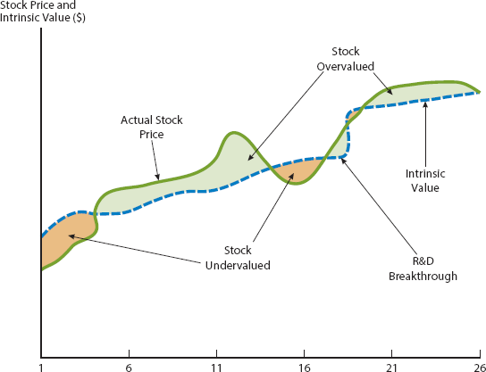
Actual Vs Intrinsic Values
Notes:
Intrinsic value long term concept. More important to focus on than current market price.
Wells Fargo fake accounts. Focus on short term bonus to detriment of long term success.

Slide 10
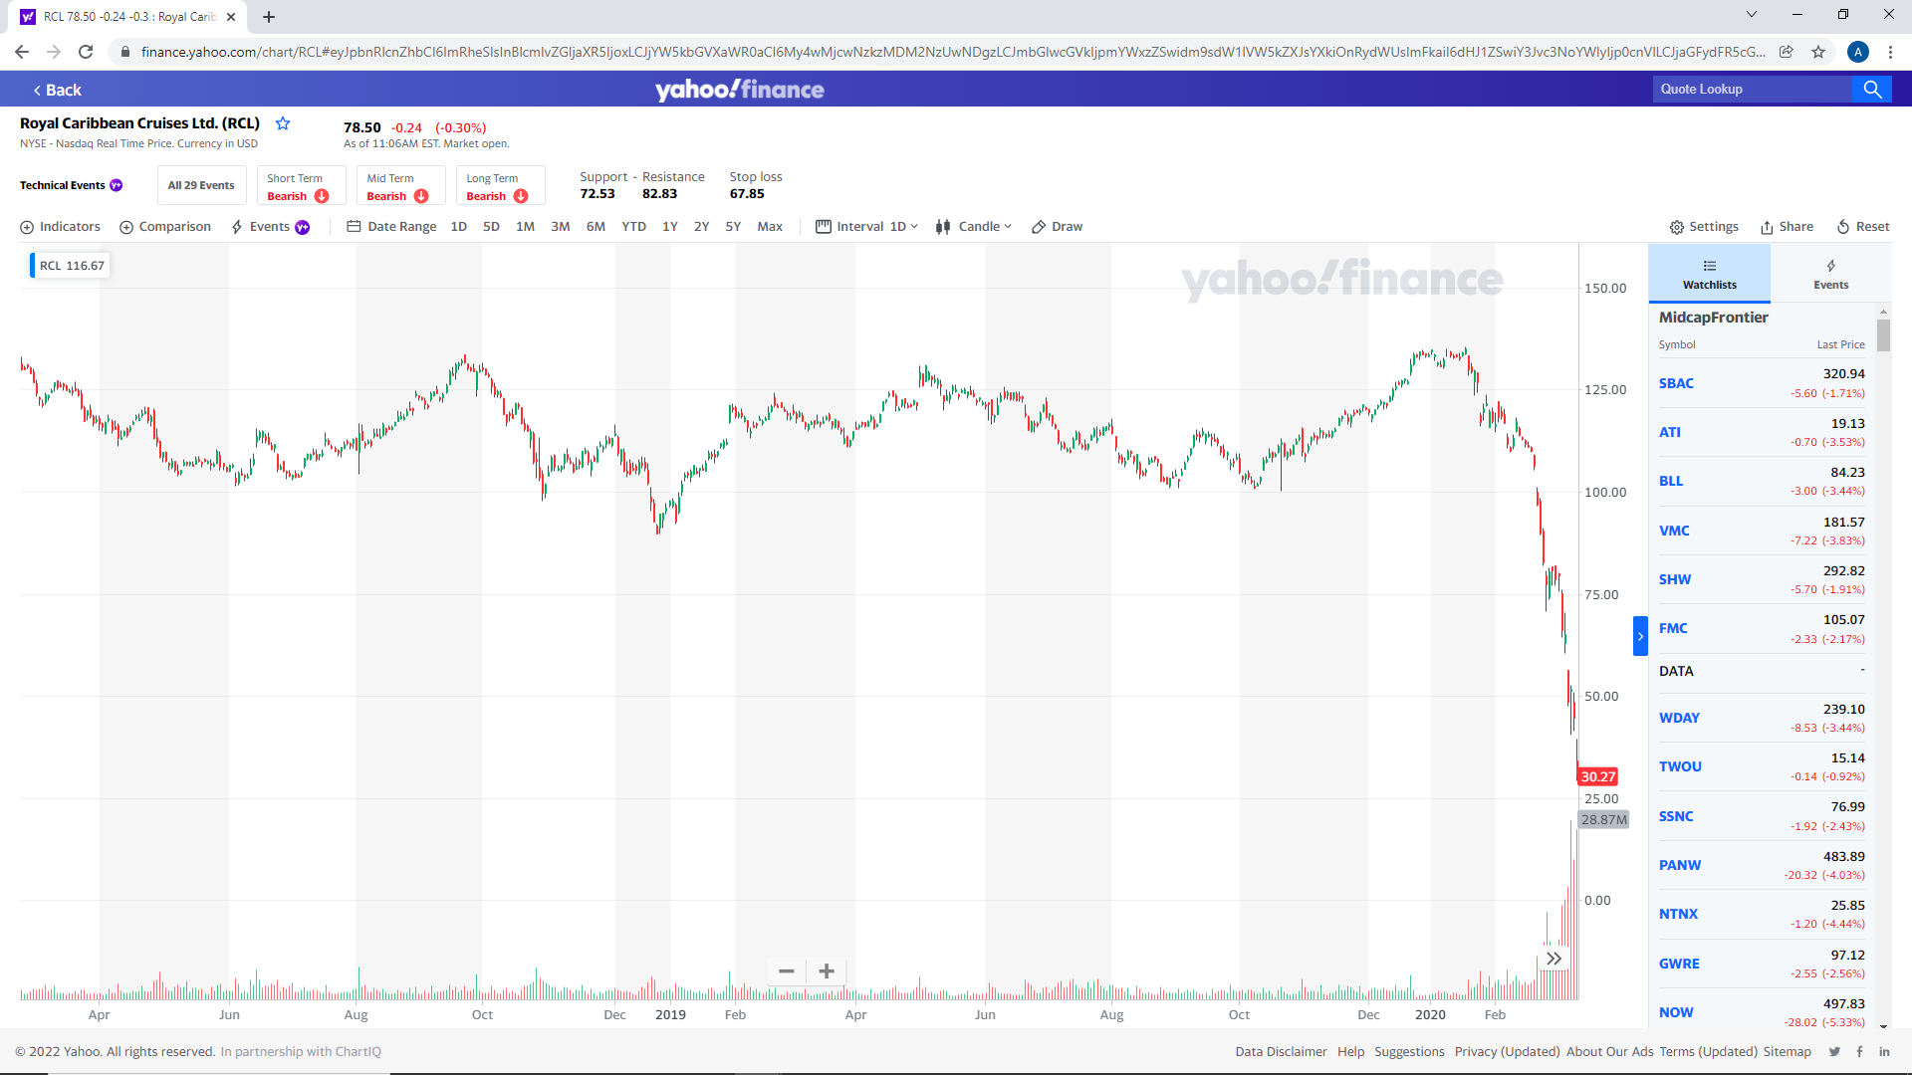
Covid came into our world and RCL down ~$90

Slide 11
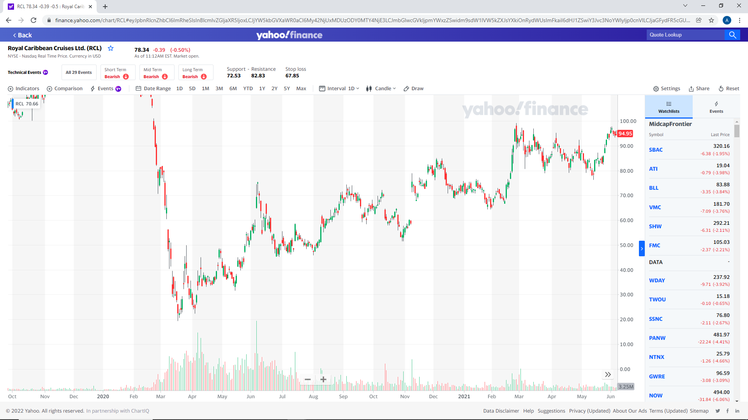
Andrew Out!!!!
Andrew In!!!

Slide 13
Stockholder-Manager Conflicts
Managers are naturally inclined to act in their own best interests (which are not always the same as the interest of stockholders).
But the following factors affect managerial behavior:
Managerial compensation packages
Direct intervention by shareholders
The threat of firing
The threat of takeover
Notes:
Make note of concentration of ownership.

Slide 14
Stockholder-Debtholder Conflicts
Stockholders are more likely to prefer riskier projects, because they receive more of the upside if the project succeeds. By contrast, bondholders receive fixed payments and are more interested in limiting risk.
Bondholders are particularly concerned about the use of additional debt.
Bondholders attempt to protect themselves by including covenants in bond agreements that limit the use of additional debt and constrain managers’ actions.

Slide 15
Balancing Shareholder Interests and Society Interests
The primary financial goal of management is shareholder wealth maximization, which translates to maximizing stock price.
Value of any asset is present value of cash flow stream to owners.
Most significant decisions are evaluated in terms of their financial consequences.
Stock prices change over time as conditions change and as investors obtain new information about a company’s prospects.
Managers recognize that being socially responsible is not inconsistent with maximizing shareholder value.

