Slide 1
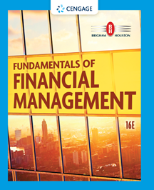
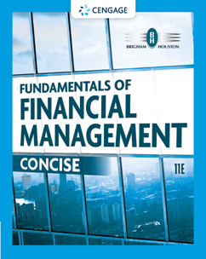
Chapter 2
Financial Markets and Institutions
Brigham & Houston, Fundamentals of Financial Management, Sixteenth Edition. © 2022 Cengage. All Rights Reserved. May not be scanned, copied or duplicated, or posted to a publicly accessible website, in whole or in part.

Slide 2
Overview
The Capital Allocation Process
Financial Markets
Financial Institutions
Stock Markets and Returns
Stock Market Efficiency

Slide 3
How is Capital Transferred Between Savers and Borrowers
Direct transfers
Investment banks
Financial intermediaries

Slide 4
The Capital Allocation Process
In a well-functioning economy, capital flows efficiently from those who supply capital to those who demand it.​
Suppliers of capital: individuals and institutions with “excess funds.” These groups are saving money and looking for a rate of return on their investment.​
Demanders or users of capital: individuals and institutions who need to raise funds to finance their investment opportunities. These groups are willing to pay a rate of return on the capital they borrow.​

Slide 5
What is a market?
A market is a venue where goods and services are exchanged.
A financial market is a place where individuals and organizations wanting to borrow funds are brought together with those having a surplus of funds.

Slide 6
Types of Financial Markets
Physical assets vs. Financial assets
Money vs. Capital
Primary vs. Secondary
Public vs. Private
Spot vs. Futures

Slide 7
The Importance of Financial Markets
Well-functioning financial markets facilitate the flow of capital from investors to the users of capital.
Markets provide savers with returns on their money saved/invested, which provide them money in the future.
Markets provide users of capital with the necessary funds to finance their investment projects.
Well-functioning markets promote economic growth.
Economies with well-developed markets perform better than economies with poorly-functioning markets.

Slide 8
Derivatives
What are derivatives? How can they be used to reduce or increase risk?
A derivative security’s value is “derived” from the price of another security (e.g., options and futures).
Can be used to “hedge” or reduce risk. For example, an importer, whose profit falls when the dollar loses value, could purchase currency futures that do well when the dollar weakens.
Also, speculators can use derivatives to bet on the direction of future stock prices, interest rates, exchange rates, and commodity prices. In many cases, these transactions produce high returns if you guess right, but large losses if you guess wrong. Here, derivatives can increase risk.

Slide 9
Types of Financial Institutions
Investment banks
Commercial banks
Financial services corporations
Pension funds
Mutual funds
Exchange traded funds
Hedge funds
Private equity funds

Slide 10
Stock Market Transactions
Apple decides to issue additional stock with the assistance of its investment banker. An investor purchases some of the newly issued shares. Is this a primary market transaction or a secondary market transaction?
Since new shares of stock are being issued, this is a primary market transaction.
What if instead an investor buys existing shares of Apple stock in the open market. Is this a primary or secondary market transaction?
Since no new shares are created, this is a secondary market transaction.

Slide 11
What is an IPO?
An initial public offering (IPO) occurs when a company issues stock in the public market for the first time.
“Going public” enables a company’s owners to raise capital from a wide variety of outside investors. Once issued, the stock trades in the secondary market.
Public companies are subject to additional regulations and reporting requirements.

Slide 12
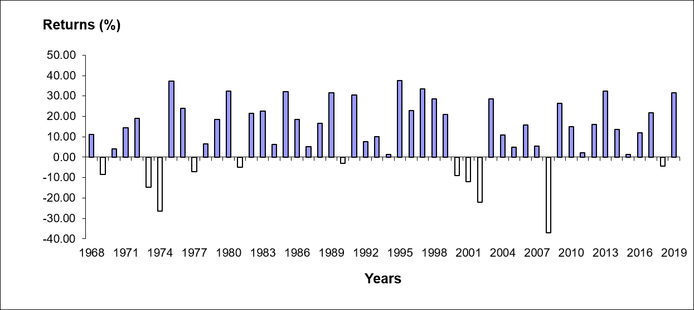
S&P 500 Index, Total Returns: Dividend Yield + Capital Gain or Loss, 1968-2019
Sources: Data taken from various issues of The Wall Street Journal “Investment Scoreboard” section and “S&P 500 Annual Total Return Historical Data” (ycharts.com/indicators/sandp_500_total_return_annual), March 27, 2020.

Slide 13
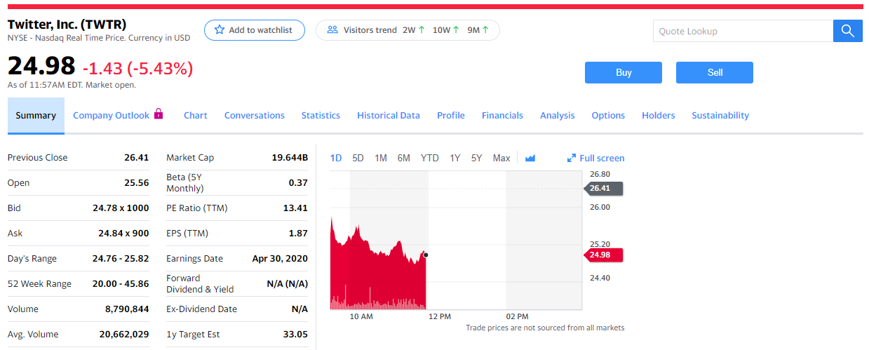
Stock Quote for Twitter, Inc., March 27, 2020
Source: Twitter, Inc. (TWTR), finance.yahoo.com.
Stock quotes can be found in a variety of print sources (The Wall Street Journal or the local newspaper) and online sources (Yahoo! Finance, CNN Money, or MSN Money).

Slide 14
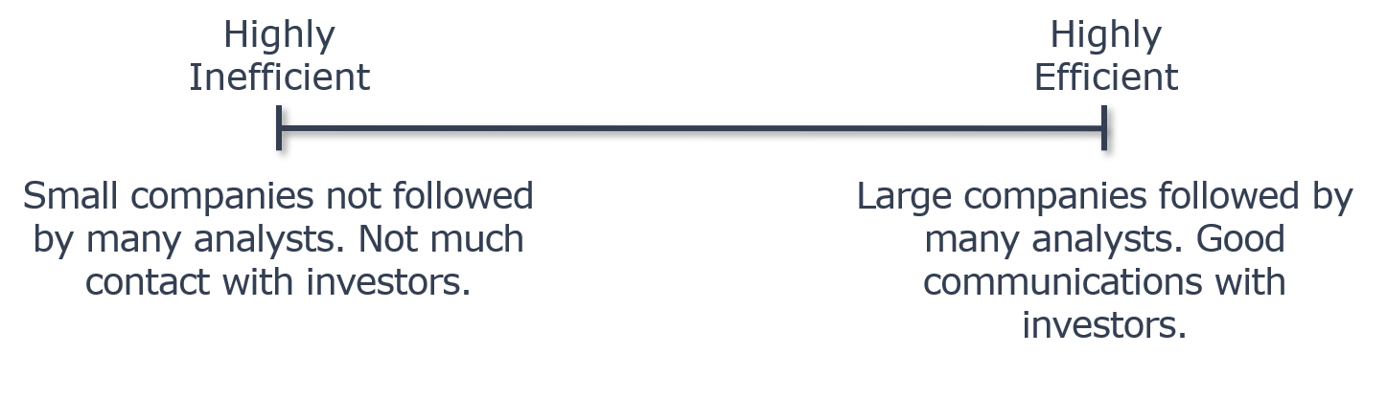
What is meant by stock market efficiency?
Securities are normally in equilibrium and are “fairly priced.”
Investors cannot “beat the market” except through good luck or better information.
Efficiency continuum

Slide 15
Implications of Market Efficiency
You hear in the news that a medical research company received FDA approval for one of its products. If the market is highly efficient, can you expect to take advantage of this information by purchasing the stock?
No. If the market is efficient, this information will already have been incorporated into the company’s stock price. So, it’s probably too late for you to “capitalize” on the information.

Slide 16

Implications of Market Efficiency
A small investor has been reading about a “hot” IPO that is scheduled to go public later this week. She wants to buy as many shares as she can get her hands on and is planning on buying a lot of shares the first day once the stock begins trading. Would you advise her to do this?
Probably not. The long-run track record of hot IPOs is not that great, unless you are able to get in on the ground floor and receive an allocation of shares before the stock begins trading. It is usually hard for small investors to receive shares of hot IPOs before the stock begins trading.

Slide 17
Behavioral Finance:
Possible Implications for Market Efficiency
It is costly and/or risky for traders to take advantage of mispriced assets.
Cognitive biases cause investors to make systematic mistakes that lead to inefficiencies. This is an area of research known as “behavioral finance.” Behavioral finance borrows insights from psychology to better understand how irrational behavior can be sustained over time. Some examples include:
Evaluating risks differently in up and down markets.
Investors become "anchored" to certain viewpoints and fail to optimally respond to new information that conflicts with their existing views.

