Slide 1
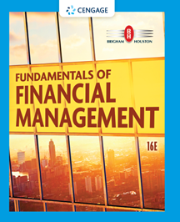
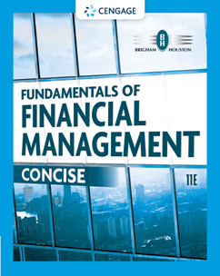
Chapter 5
Time Value of Money
Brigham & Houston, Fundamentals of Financial Management, Sixteenth Edition. © 2022 Cengage. All Rights Reserved. May not be scanned, copied or duplicated, or posted to a publicly accessible website, in whole or in part.

Slide 2
Overview
Future Value
Present Value
Finding I and N
Annuities
Rates of Return
Amortization

Slide 3
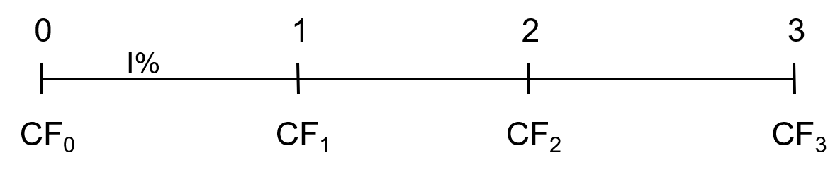
Time Lines
Show the timing of cash flows.
Tick marks occur at the end of periods, so Time 0 is today; Time 1 is the end of the first period (year, month, etc.) or the beginning of the second period.

Slide 4
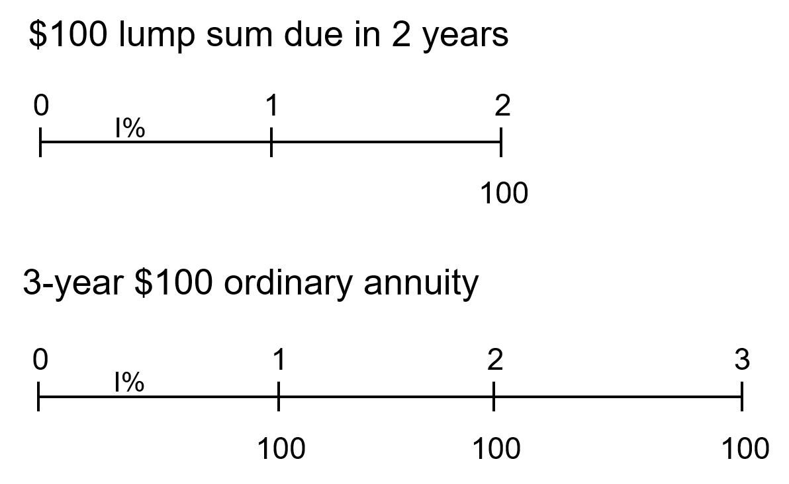
Drawing Time Lines (1 of 2)
$100 lump sum due in 2 years
3-year $100 ordinary annuity

Slide 5
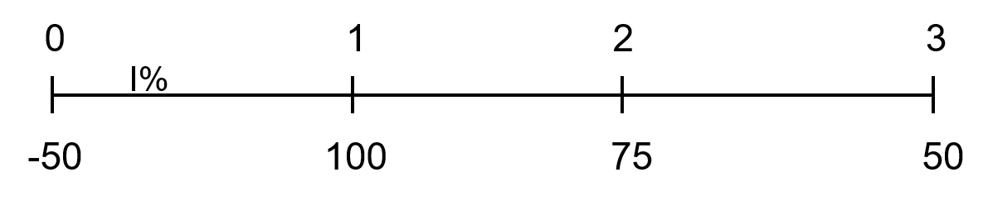
Drawing Time Lines (2 of 2)
Uneven cash flow stream

Slide 6
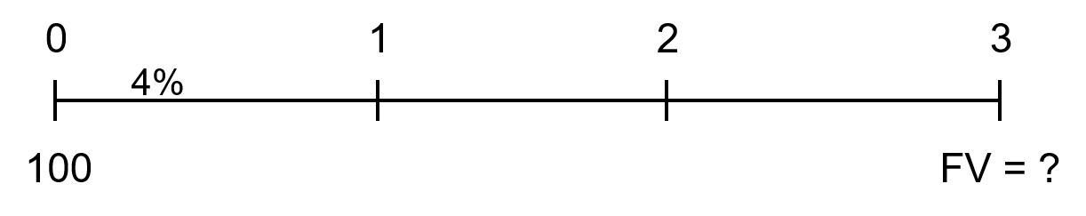
What is the future value (FV) of an initial $100 after 3 years, if I/YR = 4%?
Finding the FV of a cash flow or series of cash flows is called compounding.
FV can be solved by using the step-by-step, financial calculator, and spreadsheet methods.

Slide 7
Solving for FV: The Step-by-Step and Formula Methods
After 1 year:
FV₁ = PV(1 + I) = $100(1.04) = $104.00
After 2 years:
FV₂ = PV(1 + I)² = $100(1.04)² = $108.16
After 3 years:
FV₃ = PV(1 + I)³ = $100(1.04)³ = $112.49
After N years (general case):
FV_{N} = PV(1 + I)^{N}

Slide 8
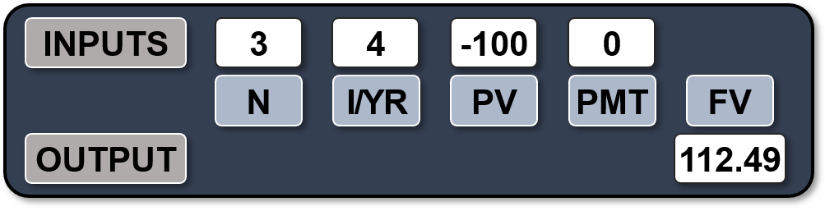
Solving for FV: Calculator and Excel Methods
Solves the general FV equation.
Requires 4 inputs into calculator, and will solve for the fifth. (Set to P/YR = 1 and END mode.)
Excel: =FV(rate,nper,pmt,pv,type)

Slide 9
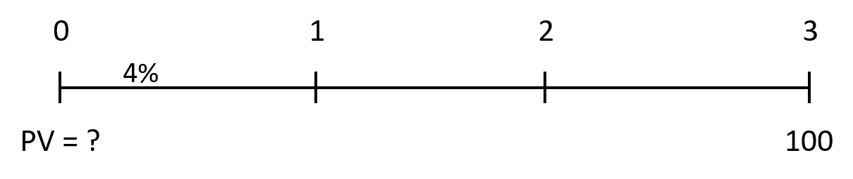
Present Value
What is the present value (PV) of $100 due in 3 years, if I/YR = 4%?
  Finding the PV of a cash flow or series of cash flows is called discounting (the reverse of compounding).
  The PV shows the value of cash flows in terms of today’s purchasing power.

Slide 10
Solving for PV: The Formula Method
Solve the general FV equation for PV:
  PV = FV_{N} /(1 + I)^{N}
  PV = FV₃ /(1 + I)³
  = $100/(1.04)³
  = $88.90

Slide 11
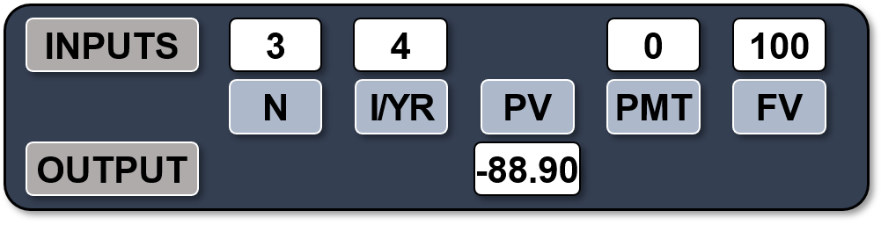
Solving for PV: Calculator and Excel Methods
Solves the general FV equation for PV.
Exactly like solving for FV, except we have different input information and are solving for a different variable.
Excel: =PV(rate,nper,pmt,fv,type)

Slide 12
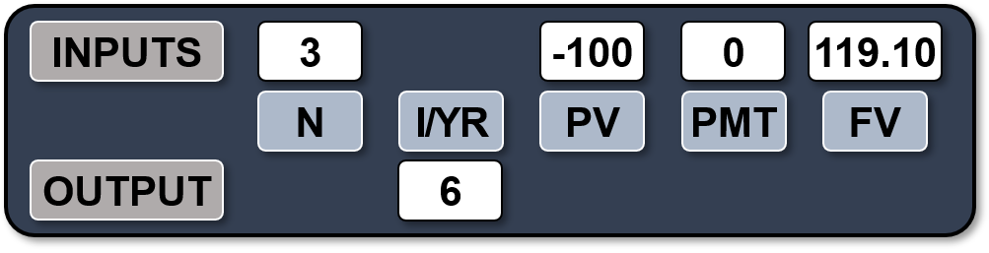
Solving for I
What annual interest rate would cause $100 to grow to $119.10 in 3 years?
  Solves the general FV equation for I/YR.
  Hard to solve without a financial calculator or spreadsheet.
Excel: =RATE(nper,pmt,pv,fv,type,guess)

Slide 13
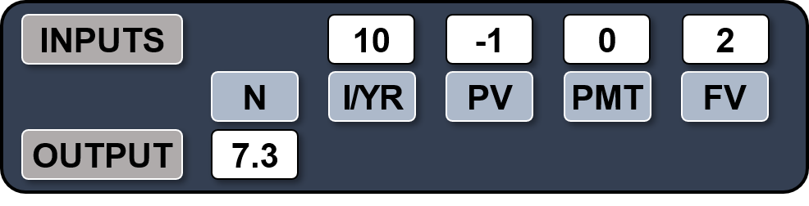
Solving for N
If sales grow at 10% per year, how long before sales double?
  Solves the general FV equation for N.
  Hard to solve without a financial calculator or spreadsheet.
Excel: =NPER(rate,pmt,pv,fv,type)

Slide 14
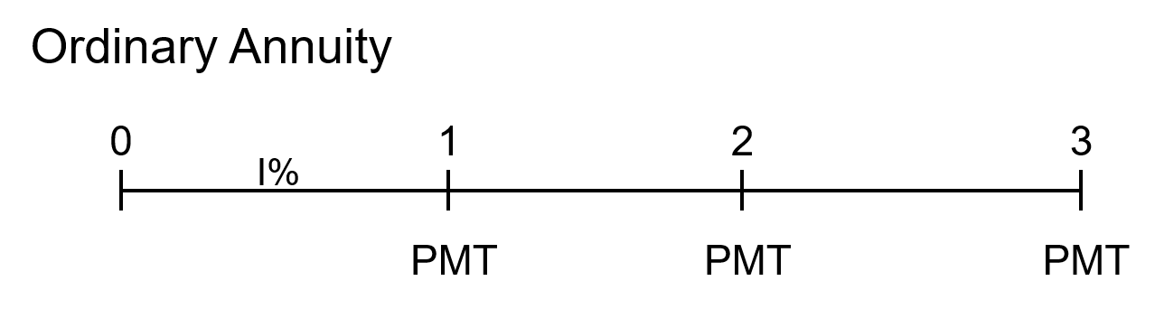
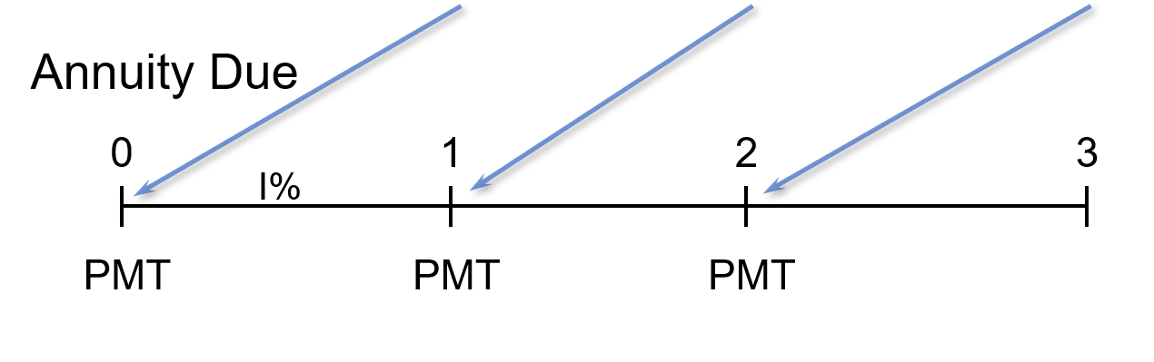
What is the difference between an ordinary annuity and an annuity due?

Slide 15
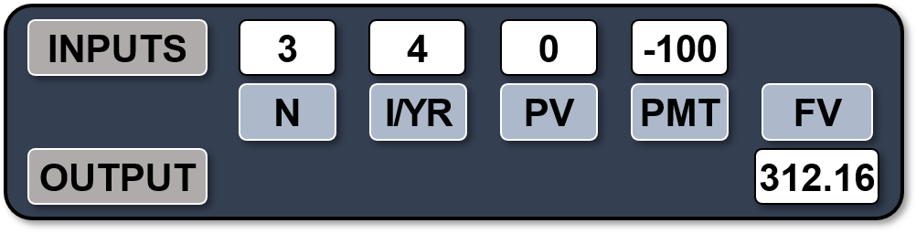
Solving for FV (1 of 3)
Given a 3-Year Ordinary Annuity of $100 at 4%
  $100 payments occur at the end of each period, but there is no PV.
Excel: =FV(rate,nper,pmt,pv,type)
Here type = 0.

Slide 16
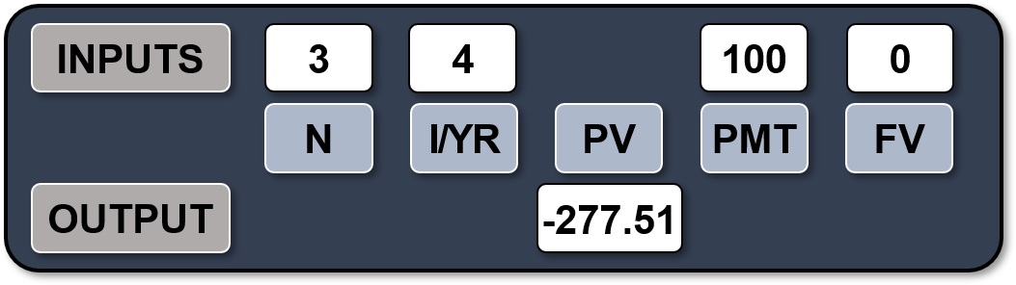
Solving for PV
Given a 3-year Ordinary Annuity of $100 at 4%
  100 payments still occur at the end of each period, but now there is no FV.
Excel: =PV(rate,nper,pmt,fv,type)
Here type = 0.

Slide 17
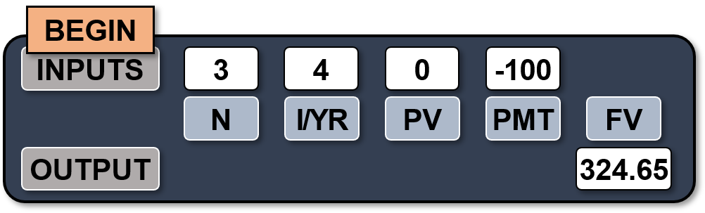
Solving for FV: 3-Year Annuity Due of $100 at 4%
Now, $100 payments occur at the beginning of each period.
FVA_{due}= FVA_{ord}(1 + I) = $312.16(1.04) = $324.65
  Alternatively, set calculator to “BEGIN” mode and solve for the FV of the annuity due:
Excel: = FV(rate,nper,pmt,pv,type)
Here type = 1.

Slide 18
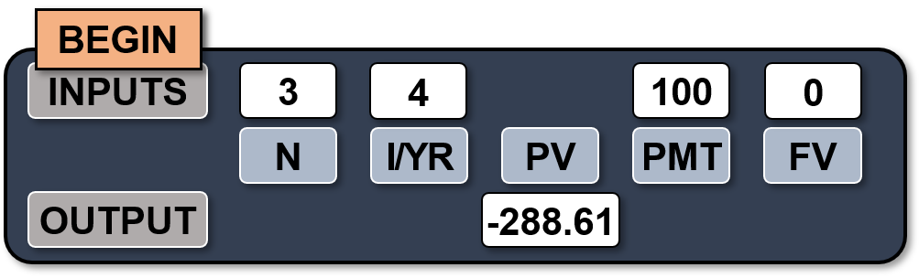
Solving for PV: 3-Year Annuity Due of $100 at 4%
Again, $100 payments occur at the beginning of each period.
PVA_{due} = PVA_{ord}(1 + I) = $277.51(1.04) = $288.61
  Alternatively, set calculator to “BEGIN” mode and solve for the PV of the annuity due:
Excel: = PV(rate,nper,pmt,fv,type)
Here type = 1.

Slide 19
PV Calculation
What is the present value of a 5-year $100 ordinary annuity at 4%?
  Be sure your financial calculator is set back to END mode and solve for PV:
    N = 5, I/YR = 4, PMT = -100, FV = 0.
    PV = $445.18.

Slide 20
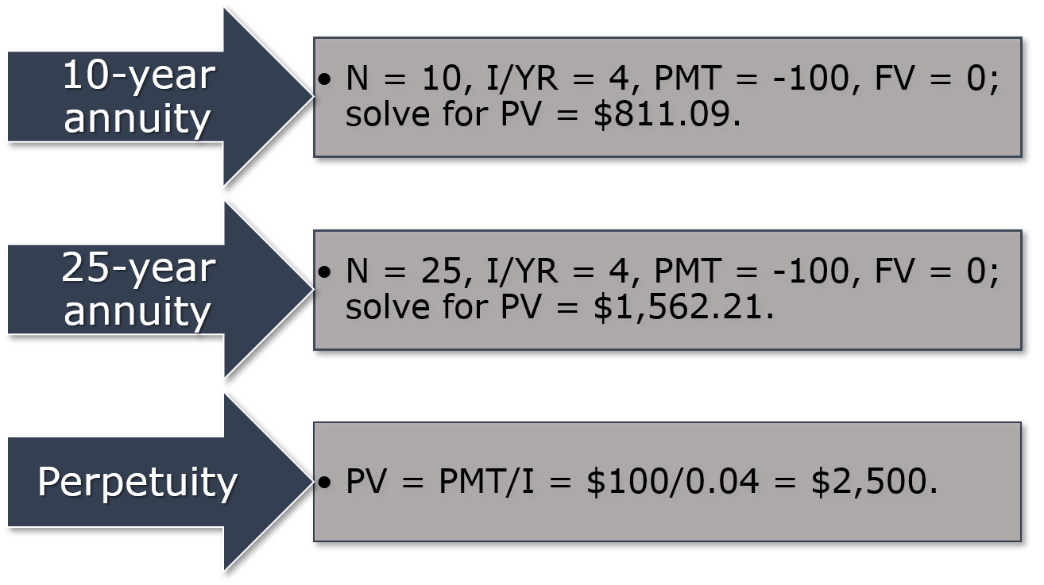
Annuities Over Time

Slide 21

The Power of Compound Interest
A 20-year-old student wants to save $5 a day for her retirement. Every day she places $5 in a drawer. At the end of the year, she invests the accumulated savings ($1,825) in a brokerage account with an expected annual return of 8%.

Slide 22
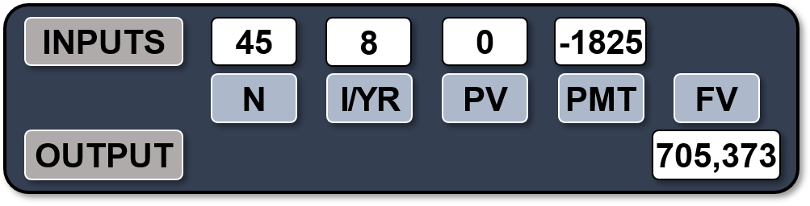
Solving for FV (2 of 3)
If she begins saving today, how much will she have when she is 65?
  If she sticks to her plan, she will have $705,373 when she is 65.
Excel: = FV(.08,45,-1825,0,0)

Slide 23
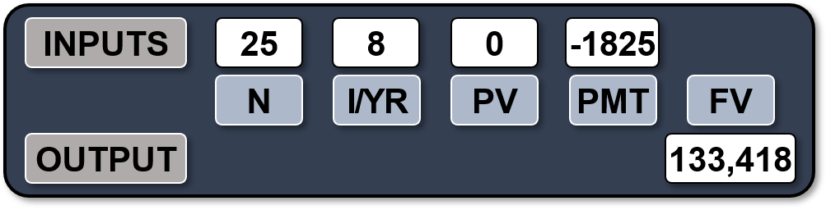
Solving for FV (3 of 3)
If you don’t start saving until you are 40 years old, how much will you have at 65?
  If a 40-year-old investor begins saving today, and sticks to the plan, he or she will have $133,418 at age 65. This is $571,954 less than if starting at age 20.
  Lesson: It pays to start saving early.
Excel: = FV(.08,45,-1825,0,0)

Slide 24
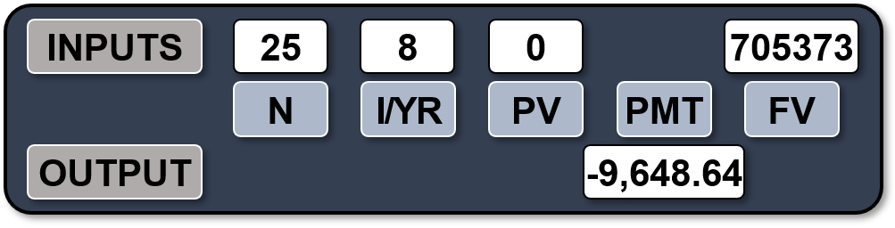
Solving for PMT
How much must the 40-year old deposit annually to catch the 20-year old?
  To find the required annual contribution, enter the number of years until retirement and the final goal of $705,372.75, and solve for PMT.
Excel: = PMT(rate,nper,pv,fv,type)
=PMT(.08,25,0,705373,0)

Slide 25
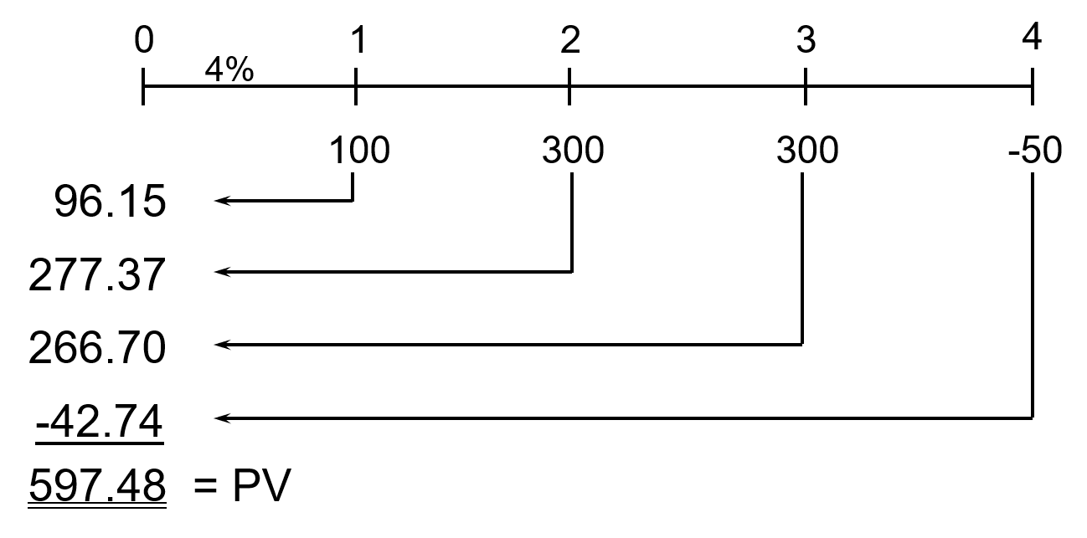
What is the PV of this uneven cash flow stream?

Slide 26
Solving for PV: Uneven Cash Flow Stream
Input cash flows in the calculator’s “CFLO” register:
  CF₀ = 0
  CF₁ = 100
  CF₂ = 300
  CF₃ = 300
  CF₄ = -50
Enter I/YR = 4, press NPV button to get NPV = $597.48. (Here NPV = PV.)

Slide 27
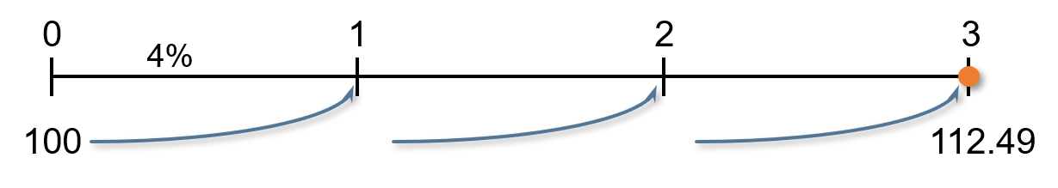
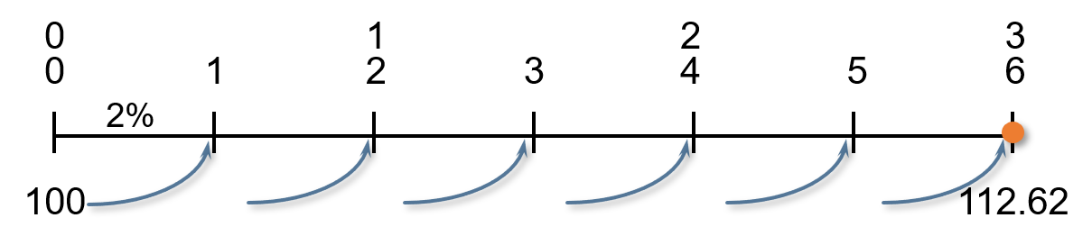
Will the FV of a lump sum be larger or smaller if compounded more often, holding the stated I% constant?
LARGER, as the more frequently compounding occurs, interest is earned on interest more often.
Annually: FV₃ = $100(1.04)³ = $112.49
Semiannually: FV₆ = $100(1.02)⁶ = $112.62

Slide 28

Classification of Interest Rates (1 of 2)
Nominal rate (I_{NOM}): also called the quoted or stated rate. An annual rate that ignores compounding effects.
Periodic rate (I_{PER}): amount of interest charged each period, e.g. monthly or quarterly.
I_{NOM} is stated in contracts. Periods must also be given, e.g. 4% quarterly or 4% daily interest.
I_{PER} = I_{NOM}/M, where M is the number of compounding periods per year. M = 4 for quarterly and M = 12 for monthly compounding.

Slide 29
Classification of Interest Rates (2 of 2)
Effective (or equivalent) annual rate (EAR = EFF%): the annual rate of interest actually being earned, considering compounding.
  EFF% for 4% semiannual interest
  EFF% = (1 + I_{NOM}/M)^{M} – 1
  = (1 + 0.04/2)² – 1 = 4.04%
  Excel: =EFFECT(nominal_rate,npery)
    =EFFECT(.04,2)
  Should be indifferent between receiving 4.04% annual interest and receiving 4% interest, compounded semiannually.

Slide 30
The Importance of Effective Rates of Return
(1 of 2)
Investments with different compounding intervals provide different effective returns.
To compare investments with different compounding intervals, you must look at their effective returns (EFF% or EAR).

Slide 31
The Importance of Effective Rates of Return
(2 of 2)
See how the effective return varies between investments with the same nominal rate, but different compounding intervals.
EAR_{ANNUAL}
EAR_{SEMIANNUALLY}
EAR_{QUARTERLY}
EAR_{MONTHLY}
EAR_{DAILY (365)}
4.00%
4.04%
4.06%
4.07%
4.08%

Slide 32
When is each rate used?
I_{NOM}: Written into contracts, quoted by banks and brokers. Not used in calculations or shown on time lines.
I_{PER}: Used in calculations and shown on time lines. If M = 1, I_{NOM} = I_{PER} = EAR.
EAR: Used to compare returns on investments with different payments per year. Used in calculations when annuity payments don’t match compounding periods.

Slide 33
Effect of Compounding on FV
What is the FV of $100 after 3 years under 4%
semiannual compounding? Quarterly compounding?

Slide 34
Effective Rate vs Nominal Rate
Can the effective rate ever be equal to the nominal rate?
  Yes, but only if annual compounding is used, i.e., if M = 1.
  If M > 1, EFF% will always be greater than the nominal rate.

Slide 35
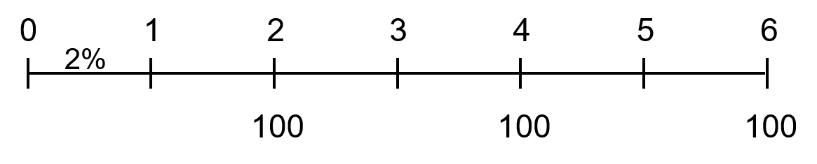
What’s the FV of a 3-year $100 annuity, if the quoted interest rate is 4%, compounded semiannually?
Payments occur annually, but compounding occurs every 6 months.
Cannot use normal annuity valuation techniques.

Slide 36
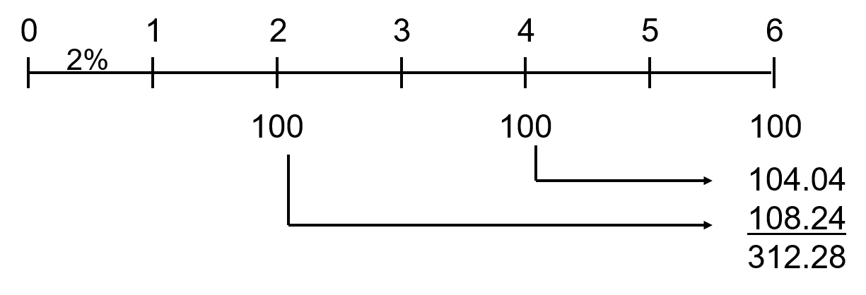
Method 1: Compound Each Cash Flow
FV₃ = $100(1.02)⁴ + $100(1.02)² + $100
FV₃ = $312.28

Slide 37
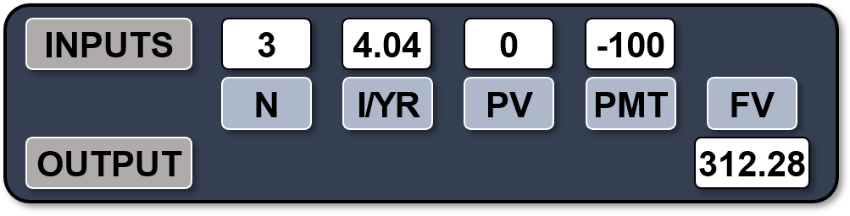
Method 2: Financial Calculator or Excel
Find the EAR and treat as an annuity.
EAR = (1 + 0.04/2)² – 1 = 4.04%.
Excel: =FV(.0404,3,-100,0,0)

Slide 38
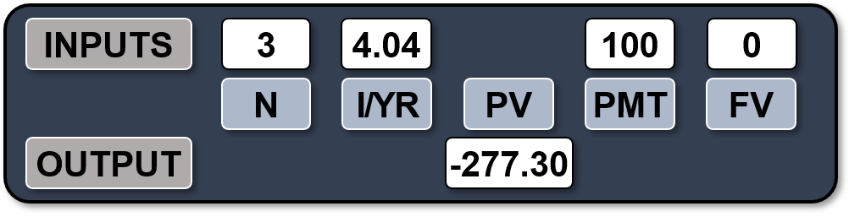
Find the PV of This 3-Year Ordinary Annuity
Could solve by discounting each cash flow, or…
Use the EAR and treat as an annuity to solve for PV.
Excel: = PV(.0404,3,100,0,0)

Slide 39
Loan Amortization
Amortization tables are widely used for home mortgages, auto loans, business loans, retirement plans, etc.
Financial calculators and spreadsheets are great for setting up amortization tables.
EXAMPLE: Construct an amortization schedule for a $1,000, 4% annual rate loan with 3 equal payments.

Slide 40
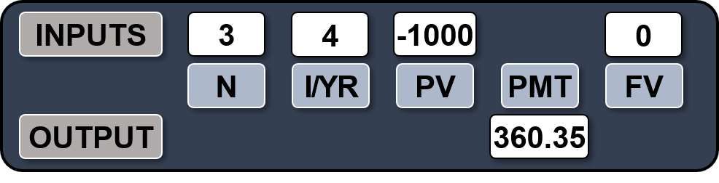
Step 1: Find the Required Annual Payment
All input information is already given, just remember that the FV = 0 because the reason for amortizing the loan and making payments is to retire the loan.
Excel: = PMT(.04,3,-1000,0,0)

Slide 41
Step 2: Find the Interest Paid in Year 1
The borrower will owe interest upon the initial balance at the end of the first year. Interest to be paid in the first year can be found by multiplying the beginning balance by the interest rate.
INT_{t} = Beg bal_{t}(I)
INT₁ = $1,000(0.04) = $40

Slide 42
Step 3: Find the Principal Repaid in Year 1
If a payment of $360.35 was made at the end of the first year and $40 was paid toward interest, the remaining value must represent the amount of principal repaid.
PRIN = PMT – INT
= $360.35 – $40 = $320.35

Slide 43
Step 4: Find the Ending Balance after Year 1
To find the balance at the end of the period, subtract the amount paid toward principal from the beginning balance.
END BAL = BEG BAL – PRIN
= $1,000 – $320.35
= $679.65

Slide 44
Constructing an Amortization Table: Repeat Steps 1-4 Until End of Loan
YEAR | BEG BAL | PMT | INT | PRIN | END BAL
1 | $1,000 | $ 360 | $40 | $ 320 | $360
2 | 680 | 360 | 27 | 333 | 347
3 | 347 | 360 | 14 | 347 | 0
TOTAL | – | $1,081 | $81 | $1,000 | –
Interest paid declines with each payment as the balance declines. What are the tax implications of this?

Slide 45
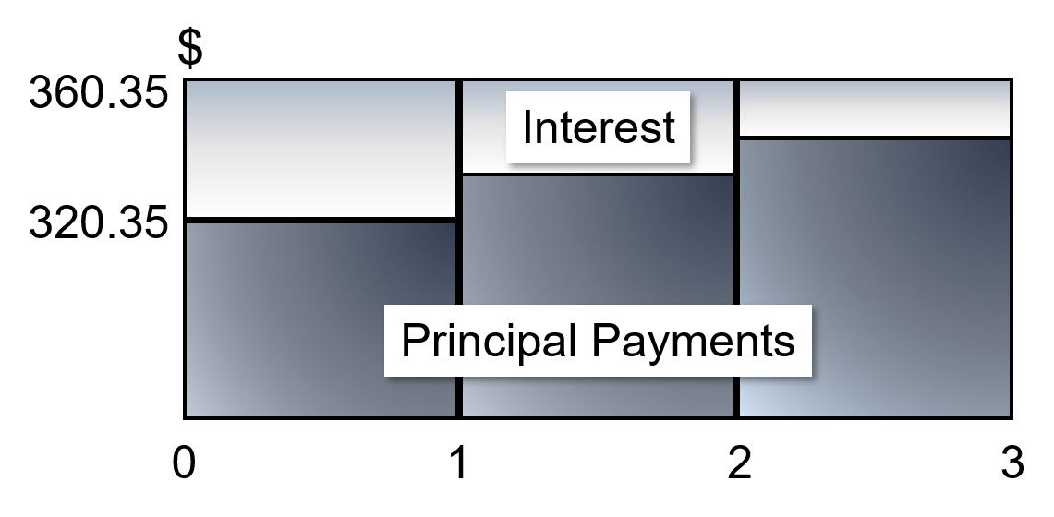
Illustrating an Amortized Payment: Where does the money go?
Constant payments
Declining interest payments
Declining balance

