Slide 1
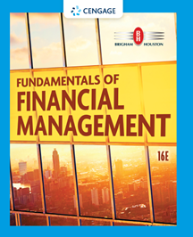
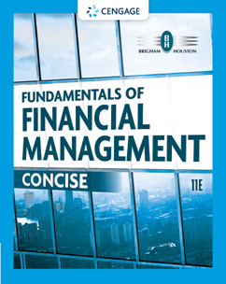
Chapter 6
Interest Rates
Brigham & Houston, Fundamentals of Financial Management, Sixteenth Edition. © 2022 Cengage. All Rights Reserved. May not be scanned, copied or duplicated, or posted to a publicly accessible website, in whole or in part.

Slide 2
Interest Rates Overview
Cost of Money and Interest Rate Levels
Determinants of Interest Rates
The Term Structure and Yield Curves
Using Yield Curves to Estimate Future Interest Rates

Slide 3
What four factors affect the level of interest rates?
Production opportunities
Time preferences for consumption
Risk
Expected inflation

Slide 4
“Nominal” vs. “Real” Rates
r = represents any nominal rate
r* = represents the “real” risk-free rate of interest. Like a T-bill rate, if there was no inflation. Typically ranges from 1% to 4% per year.
r_{RF} = represents the rate of interest on Treasury securities.

Slide 5
Determinants of Interest Rates
r = r* + IP + DRP + LP + MRP
r = required return on a debt security
r* = real risk-free rate of interest
IP = inflation premium
DRP = default risk premium
LP = liquidity premium
MRP = maturity risk premium

Slide 6
Premiums Added to r* for Different Types of Debt
 | IP | MRP | DRP | LP
S-T Treasury | ✓
L-T Treasury | ✓ | ✓
S-T Corporate | ✓ |  | ✓ | ✓
L-T Corporate | ✓ | ✓ | ✓ | ✓

Slide 7
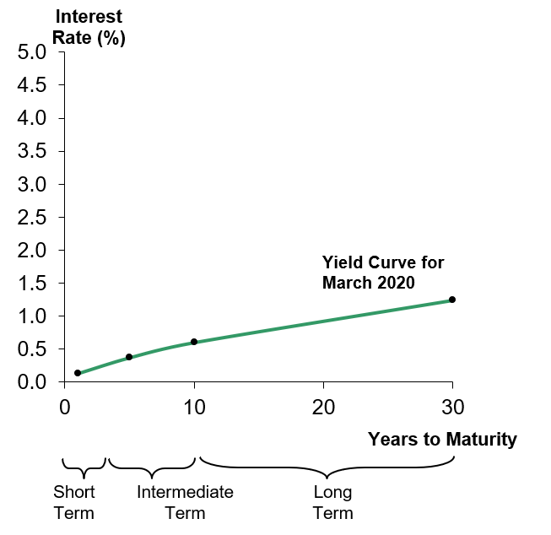
Yield Curve and the Term Structure of Interest Rates
Term structure: relationship between interest rates (or yields) and maturities.
The yield curve is a graph of the term structure.
The March 2020 Treasury yield curve is shown at the right.
Yield Curve for March 2020

Slide 8
Constructing the Yield Curve: Inflation
(1 of 2)
Step 1: Find the average expected inflation rate over Years 1 to N:

Slide 9
Constructing the Yield Curve: Inflation
(2 of 2)
Assume inflation is expected to be 5% next year, 6% the following year, and 8% thereafter.
Must earn these IPs to break even vs. inflation; these IPs would permit you to earn r* (before taxes).

Slide 10
Constructing the Yield Curve: Maturity Risk (1 of 2)
Step 2: Find the appropriate maturity risk premium (MRP). For this example, the following equation will be used to find a security’s appropriate maturity risk premium.
MRP_{t} = 0.1% (t – 1)

Slide 11
Constructing the Yield Curve: Maturity Risk (2 of 2)
Using the given equation:
Notice that since the equation is linear, the maturity risk premium is increasing as the time to maturity increases, as it should be.

Slide 12
Add the IPs and MRPs to r* to Find the Appropriate Nominal Rates
Step 3: Adding the premiums to r*.
r_{RF, t} = r* + IP_{t} + MRP_{t}
Assume r* = 3%,

Slide 13
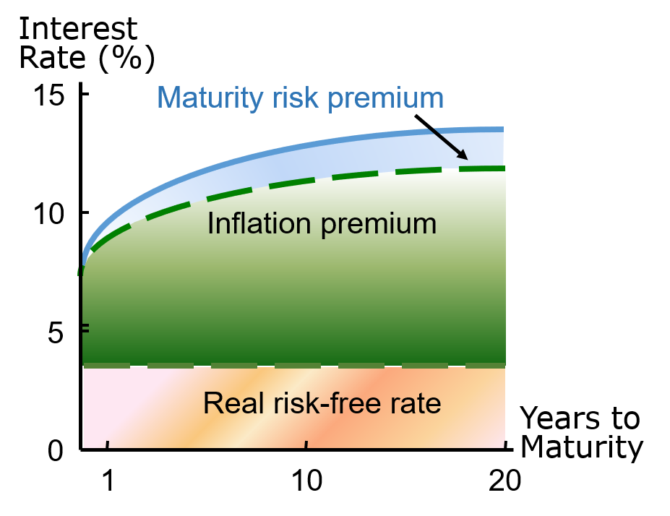
Hypothetical Yield Curve
An upward-sloping yield curve.
Upward slope due to an increase in expected inflation and increasing maturity risk premium.

Slide 14
Relationship Between Treasury Yield Curve and Yield Curves for Corporate Issues
Corporate yield curves are higher than that of Treasury securities, though not necessarily parallel to the Treasury curve.
The spread between corporate and Treasury yield curves widens as the corporate bond rating decreases.
Since corporate yields include a default risk premium (DRP) and a liquidity premium (LP), the corporate bond yield spread can be calculated as:

Slide 15
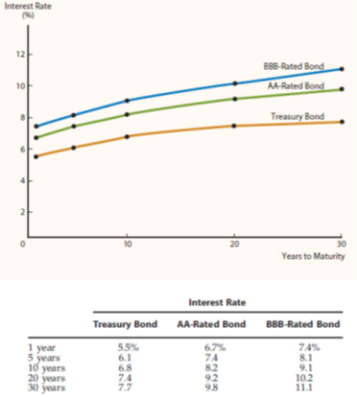
Illustrating the Relationship Between Corporate and Treasury Yield Curves

Slide 16
Pure Expectations Theory
The pure expectations theory contends that the shape of the yield curve depends on investors’ expectations about future interest rates.
If interest rates are expected to increase, L-T rates will be higher than S-T rates, and vice-versa. Thus, the yield curve can slope up, down, or even bow.

Slide 17
Assumptions of Pure Expectations
Assumes that the maturity risk premium for Treasury securities is zero.
Long-term rates are an average of current and future short-term rates.
If the pure expectations theory is correct, you can use the yield curve to “back out” expected future interest rates.

Slide 18
An Example: Observed Treasury Rates and Pure Expectations
Maturity | Yield
1 year | 6.0
2 years | 6.2
3 years | 6.4
4 years | 6.5
5 years | 6.5
If the pure expectations theory holds, what does the market expect will be the interest rate on one-year securities, one year from now? Three-year securities, two years from now?

Slide 19
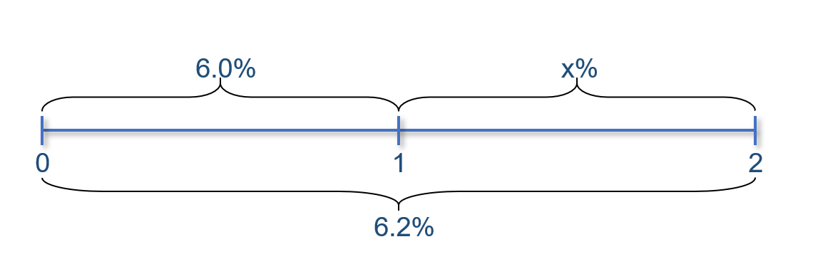
One-Year Forward Rate
The pure expectations theory says that one-year securities will yield 6.4004%, one year from now.
Notice, if an arithmetic average is used, the answer is still very close. Solve: 6.2% = (6.0% + X)/2, and the result will be 6.4%.

Slide 20
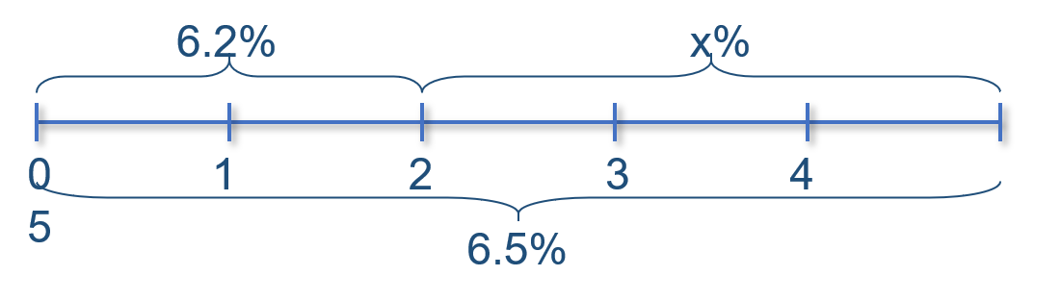
Three-Year Security, Two Years from Now
The pure expectations theory says that three-year securities will yield 6.7005%, two years from now.

Slide 21
Conclusions About Pure Expectations
Some would argue that the MRP ≠ 0, and hence the pure expectations theory is incorrect.
Most evidence supports the general view that lenders prefer S-T securities, and view L-T securities as riskier.
  Thus, investors demand a premium to persuade them to hold L-T securities (i.e., MRP > 0).

Slide 22
Macroeconomic Factors That Influence Interest Rate Levels
Federal reserve policy
Federal budget deficits or surpluses
International factors
Level of business activity

