Slide 1
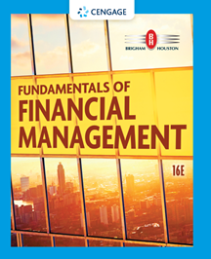
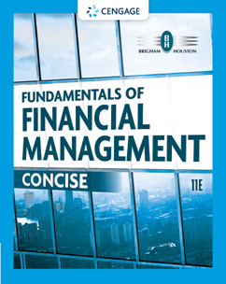
Chapter 8
Risk and Rates of Return
Brigham & Houston, Fundamentals of Financial Management, Sixteenth Edition. © 2022 Cengage. All Rights Reserved. May not be scanned, copied or duplicated, or posted to a publicly accessible website, in whole or in part.

Slide 2
Overview
Stand Alone Risk
Portfolio Risk
Risk and Return: CAPM/SML

Slide 3
What is investment risk?
Two types of investment risk
  Stand-alone risk
  Portfolio risk
Investment risk is related to the probability of earning a low or negative actual return.
The greater the chance of lower than expected, or negative returns, the riskier the investment.

Slide 4
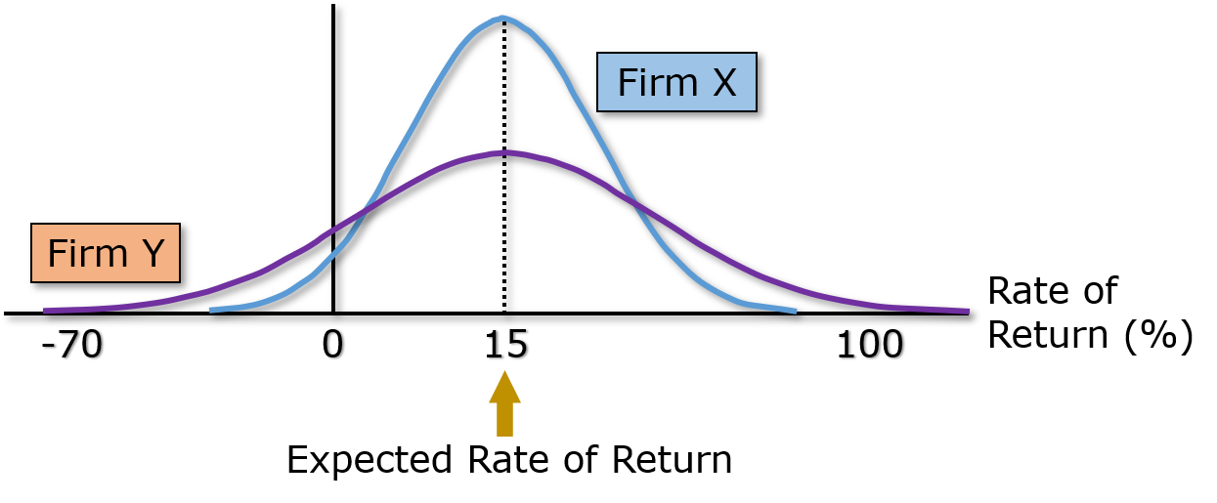
Probability Distributions
A listing of all possible outcomes, and the probability of each occurrence.
Can be shown graphically.

Slide 5
Selected Realized Returns, 1926-2019
 | Average Return | Standard Deviation
Small-cap stocks | 16.3% | 31.5%
Large-cap stocks | 12.1 | 19.8
Long-term corporate bonds | 6.4 | 8.5
Long-term government bonds | 6.0 | 9.8
U.S. Treasury bills | 3.4 | 3.1
Portfolios:
90% stocks/10% bonds | 11.4% | 17.8%
70% stocks/30% bonds | 10.2 | 14.1
Source: Based on Roger G. Ibbotson, Stocks, Bonds, Bills, and Inflation: 2020 Yearbook (Chicago, IL: Duff & Phelps, 2020), pp. 2–6, 2–23.

Slide 6
Hypothetical Investment Alternatives
Economy | Probability | T-Bills | High Tech | Collections | U.S. Rubber | Market Portfolio
Recession | 0.1 | 3.0% | −29.5% | 24.5% | 3.5% | −19.5%
Below average | 0.2 | 3.0% | −9.5% | 10.5% | −16.5% | −5.5%
Average | 0.4 | 3.0% | 12.5% | −1.0% | 0.5% | 7.5%
Above average | 0.2 | 3.0% | 27.5% | −5.0% | 38.5% | 22.5%
Boom | 0.1 | 3.0% | 42.5% | −20.0% | 23.5% | 35.5%

Slide 7
Why is the T-bill return independent of the economy? Do T-bills promise a completely risk-free return?
T-bills will return the promised 3.0%, regardless of the economy.
No, T-bills do not provide a completely risk-free return, as they are still exposed to inflation. Although, very little unexpected inflation is likely to occur over such a short period of time.
T-bills are also risky in terms of reinvestment risk.
T-bills are risk-free in the default sense of the word.

Slide 8
How do the returns of High Tech and Collections behave in relation to the market?
High Tech: Moves with the economy, and has a positive correlation. This is typical.
Collections: Is countercyclical with the economy, and has a negative correlation. This is unusual.

Slide 9
Calculating the Expected Return

Slide 10
Summary of Expected Returns
 | Expected Return
High Tech | 9.9%
Market | 8.0%
US Rubber | 7.3%
T-bills | 3.0%
Collections | 1.2%
High Tech has the highest expected return, and appears to be the best investment alternative, but is it really?
Have we failed to account for risk?

Slide 11
Calculating Standard Deviation

Slide 12
Standard Deviation for Each Investment
σ_{HT} = 20% | σ_{Coll} = 11.2%
σ_{M} = 15.2% | σ_{USR} = 18.8%

Slide 13
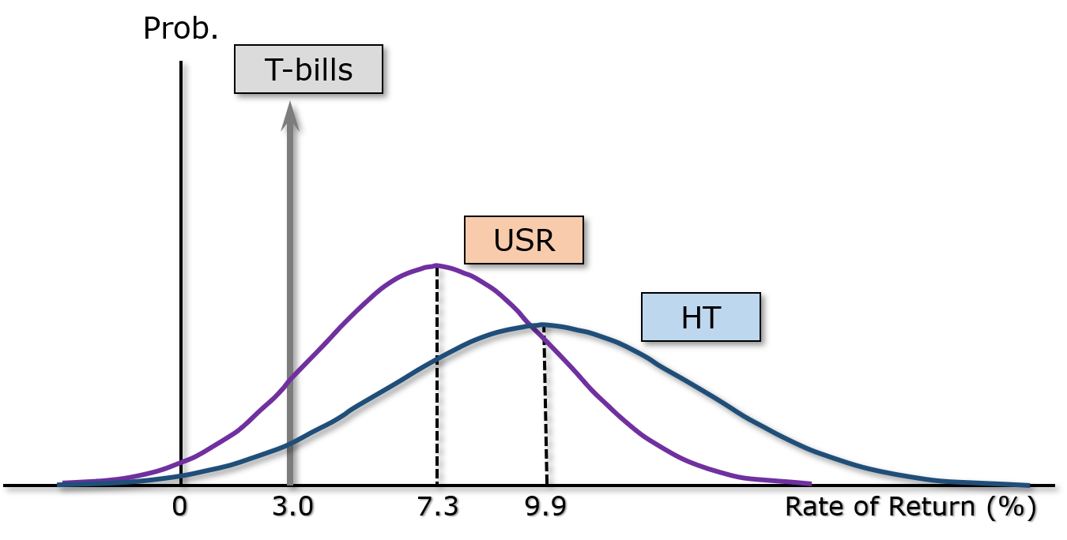
Comparing Standard Deviations

Slide 14
Comments on Standard Deviation as a Measure of Risk
Standard deviation (σ_{i}) measures total, or stand-alone, risk.
The larger σ_{i} is, the lower the probability that actual returns will be close to expected returns.
Larger σ_{i} is associated with a wider probability distribution of returns.

Slide 15
Comparing Risk and Return
Security | Expected Return, | Risk, σ
T-bills | 3.0% | 0.0%
High Tech | 9.9 | 20.0
Collections* | 1.2 | 11.2
US Rubber* | 7.3 | 18.8
Market | 8.0 | 15.2
*Seems out of place.

Slide 16
Coefficient of Variation (CV)
A standardized measure of dispersion about the expected value, that shows the risk per unit of return.

Slide 17
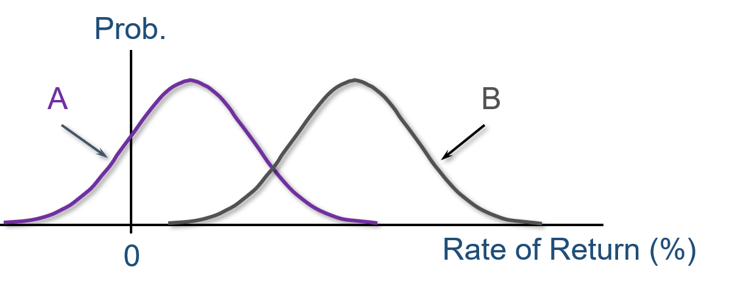
Illustrating the CV as a Measure of Relative Risk
σ_{A} = σ_{B} , but A is riskier because of a larger probability of losses. In other words, the same amount of risk (as measured by σ) for smaller returns.

Slide 18
Risk Rankings by Coefficient of Variation
CV
T-bills 0.0
Market 1.9
High Tech 2.0
US Rubber 2.6
Collections 9.8
Collections has the highest degree of risk per unit of return.
High Tech, despite having the highest standard deviation of returns, has a relatively average CV.

Slide 19
Sharpe Ratio
The Sharpe ratio is an alternative measure of stand-alone risk. It looks at excess return relative to risk.
  High Tech’s Sharpe ratio = (9.9% - 3%)/20.0% = 0.345
  U.S. Rubber’s Sharpe ratio = (7.3% - 3%)/18.8% = 0.229
  Market Portfolio’s Sharpe ratio = (8% - 3%)/15.2% = 0.329
  Collections’ Sharpe ratio = (1.2% - 3%)/11.2% = -0.161
  T-Bills’ Sharpe ratio = 0.
Excess return is asset’s return minus the risk-free rate.
Risk is measured as the standard deviation of the asset’s return.
A risk-free asset will have a Sharpe ratio = 0.

Slide 20
Investor Attitude Towards Risk
Risk premium: the difference between the return on a risky asset and a riskless asset, which serves as compensation for investors to hold riskier securities.
Risk aversion: assumes investors dislike risk and require higher rates of return to encourage them to hold riskier securities.

Slide 21
Portfolio Construction: Risk and Return
Assume a two-stock portfolio is created with $50,000 invested in both High Tech and Collections.
A portfolio’s expected return is a weighted average of the returns of the portfolio’s component assets.
Standard deviation is a little more tricky and requires that a new probability distribution for the portfolio returns be constructed.

Slide 22
Calculating Portfolio Expected Return

Slide 23
An Alternative Method for Determining Portfolio Expected Return
Economy | Probability | High Tech | Collections | Portfolio
Recession | 0.1 | −29.5% | 24.5% | −2.5%
Below average | 0.2 | −9.5% | 10.5% | 0.5%
Average | 0.4 | 12.5% | −1.0% | 5.8%
Above average | 0.2 | 27.5% | −5.0% | 11.3%
Boom | 0.1 | 42.5% | −20.0% | 11.3%

Slide 24
Calculating Portfolio Standard Deviation,
CV, and Sharpe Ratio
Sharpe ratio = (5.5% − 3%)/4.6%
= 0.543

Slide 25
Comments on Portfolio Risk Measures
σ_{p} = 4.6% is much lower than the σ_{i} of either stock (σ_{HT} = 20.0%; σ_{Coll} = 11.2%).
σ_{p} = 4.6% is lower than the weighted average of High Tech and Collections’ σ (15.6%).
Therefore, the portfolio provides the average return of component stocks, but lower than the average risk.
Why? Negative correlation between stocks.

Slide 26
General Comments About Risk
σ ~35% for an average stock.
Most stocks are positively (though not perfectly) correlated with the market (i.e., ρ between 0 and 1).
Combining stocks in a portfolio generally lowers risk.

Slide 27
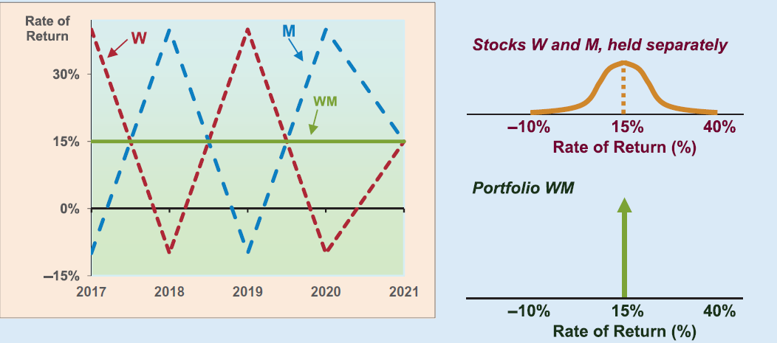
Returns Distribution for Two Perfectly Negatively Correlated Stocks (ρ = -1.0)

Slide 28
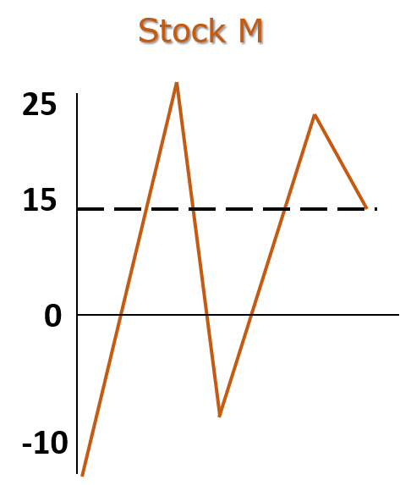
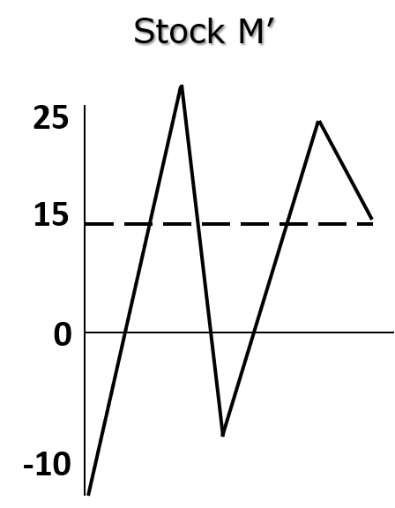
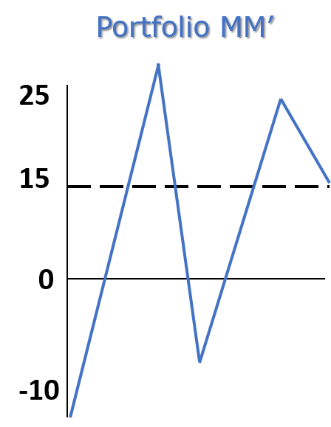
Returns Distribution for Two Perfectly Positively Correlated Stocks (ρ = 1.0)

Slide 29
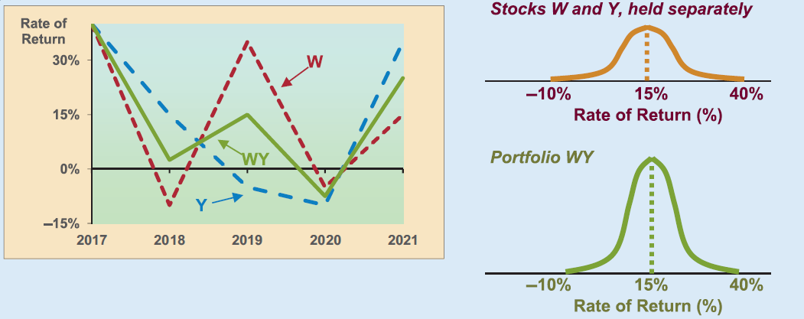
Partial Correlation, ρ = +0.35

Slide 30
Creating a Portfolio: Beginning with One Stock and Adding Randomly Selected Stocks to Portfolio
σ_{p} decreases as stocks are added, because they would not be perfectly correlated with the existing portfolio.
Expected return of the portfolio would remain relatively constant.
Eventually the diversification benefits of adding more stocks dissipates (after about 40 stocks), and for large stock portfolios, σ_{p} tends to converge to ≈ 20%.

Slide 31
Illustrating Diversification Effects of a
Stock Portfolio

Slide 32
Breaking Down Sources of Risk
Stand-alone risk = Market risk + Diversifiable risk
Market risk: portion of a security’s stand-alone risk that cannot be eliminated through diversification. Measured by beta.
Diversifiable risk: portion of a security’s stand-alone risk that can be eliminated through proper diversification.

Slide 33
Failure to Diversify
If an investor chooses to hold a one-stock portfolio (doesn’t diversify), would the investor be compensated for the extra risk they bear?
  NO!
  Stand-alone risk is not important to a well-diversified investor.
  Rational, risk-averse investors are concerned with σ_{p}, which is based upon market risk.
  There can be only one price (the market return) for a given security.
  No compensation should be earned for holding unnecessary, diversifiable risk.

Slide 34
Capital Asset Pricing Model (CAPM)
Model linking risk and required returns. CAPM suggests that there is a Security Market Line (SML) that states that a stock’s required return equals the risk-free return plus a risk premium that reflects the stock’s risk after diversification.
Primary conclusion: The relevant riskiness of a stock is its contribution to the riskiness of a well-diversified portfolio.

Slide 35
Beta
Measures a stock’s market risk, and shows a stock’s volatility relative to the market.
Indicates how risky a stock is if the stock is held in a well-diversified portfolio.

Slide 36
Comments on Beta
If beta = 1.0, the security is just as risky as the average stock.
If beta > 1.0, the security is riskier than average.
If beta < 1.0, the security is less risky than average.
Most stocks have betas in the range of 0.5 to 1.5.

Slide 37
Can the beta of a security be negative?
Yes, if the correlation between Stock i and the market is negative (i.e., ρ_{i,m} < 0).
If the correlation is negative, the regression line would slope downward, and the beta would be negative.
However, a negative beta is highly unlikely.

Slide 38
Calculating Betas
Well-diversified investors are primarily concerned with how a stock is expected to move relative to the market in the future.
Without a crystal ball to predict the future, analysts are forced to rely on historical data. A typical approach to estimate beta is to run a regression of the security’s past returns against the past returns of the market.
The slope of the regression line is defined as the beta coefficient for the security.

Slide 39
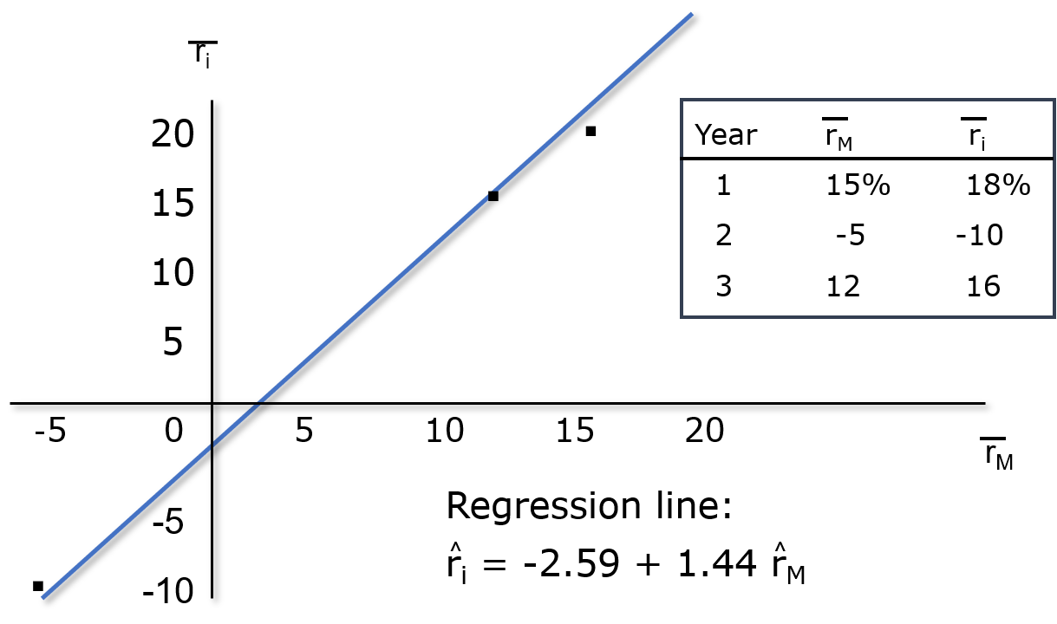
Illustrating the Calculation of Beta

Slide 40
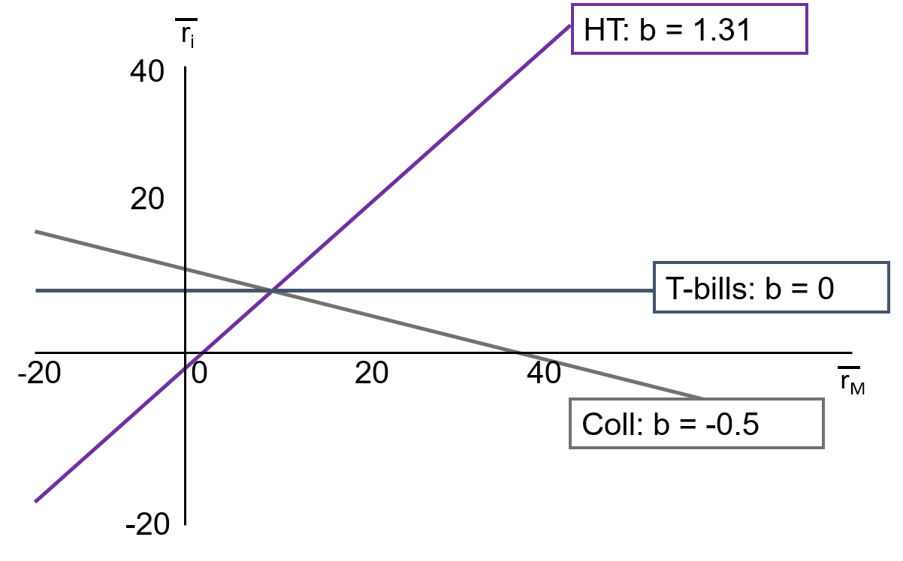
Beta Coefficients for High Tech, Collections, and T-Bills

Slide 41
Comparing Expected Returns and Beta Coefficients
Security | Expected Return | Beta
High Tech | 9.9% | 1.31
Market | 8.0 | 1.00
US Rubber | 7.3 | 0.88
T-Bills | 3.0 | 0.00
Collections | 1.2 | −0.50
Riskier securities have higher returns, so the rank order is OK.

Slide 42
The Security Market Line (SML): Calculating Required Rates of Return
Assume the yield curve is flat and that r_{RF} = 3.0% and

Slide 43
What is the market risk premium?
Additional return over the risk-free rate needed to compensate investors for assuming an average amount of risk.
Its size depends on the perceived risk of the stock market and investors’ degree of risk aversion.
Varies from year to year, but most estimates suggest that it ranges between 4% and 8% per year.

Slide 44
Calculating Required Rates of Return
r_{HT} | = | 3.0% + (5.0%)(1.31)
r_{M} | = | 3.0% + 6.55% | = | 9.55%
r_{USR} | = | 3.0% + (5.0%)(1.00) | = | 8.00%
r_{T-bill} | = | 3.0% + (5.0%)(0.88) | = | 7.40%
 | = | 3.0% + (5.0)(0.00) | = | 3.00%
r_{Coll} | = | 3.0% + (5.0%)(−0.50) | = | 0.50%

Slide 45
Expected vs. Required Returns
 |  | r
High Tech | 9.9% | 9.55% | Undervalued
Market | 8.0 | 8.00 | Fairly valued
US Rubber | 7.3 | 7.40 | Overvalued
T-bills | 3.0 | 3.00 | Fairly valued
Collections | 1.2 | 0.50 | Undervalued

Slide 46
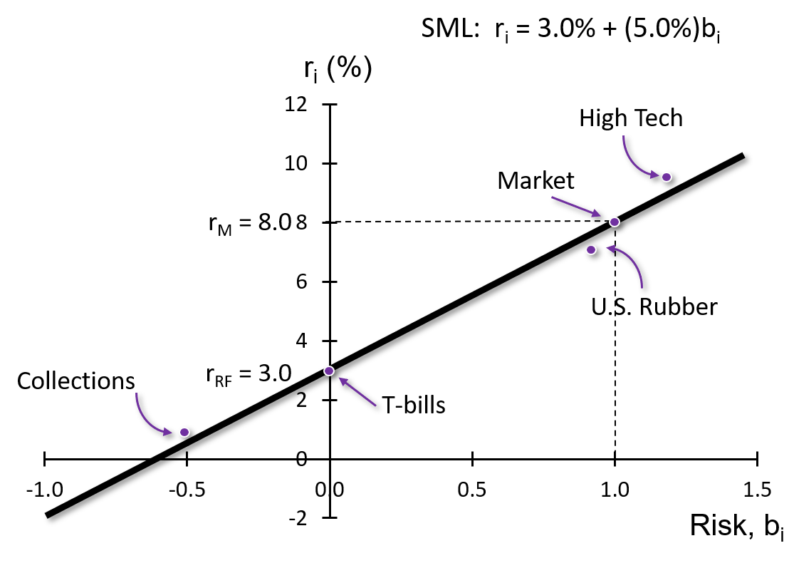
Illustrating the Security Market Line

Slide 47
An Example: Equally-Weighted Two-Stock Portfolio
Create a portfolio with 50% invested in High Tech and 50% invested in Collections.
The beta of a portfolio is the weighted average of each of the stock’s betas.

Slide 48
Calculating Portfolio Required Returns
The required return of a portfolio is the weighted average of each of the stock’s required returns.
Or, using the portfolio’s beta, CAPM can be used to solve for the portfolio’s required return.

Slide 49
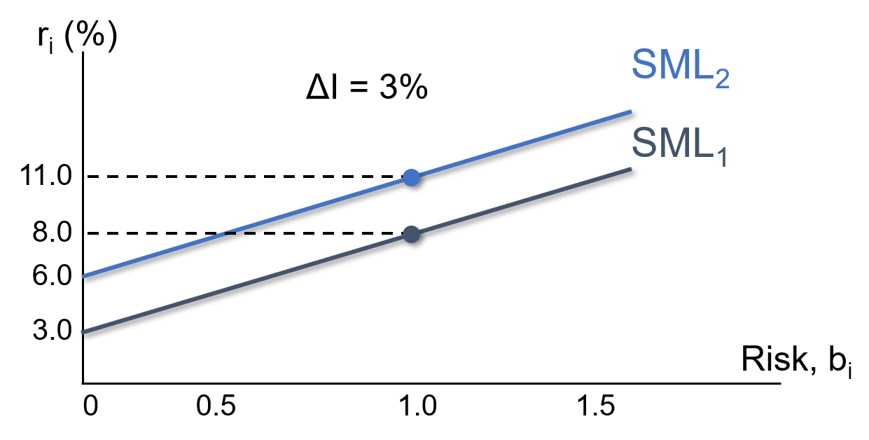
Factors That Change the SML (1 of 2)
If investors raise inflation expectations by 3%, what would happen to the SML?

Slide 50
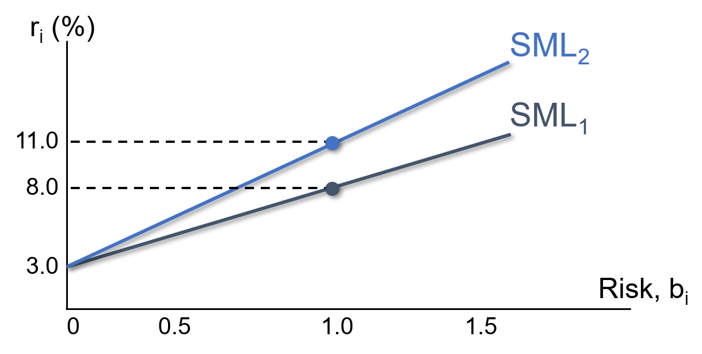
Factors That Change the SML (2 of 2)
If investors’ risk aversion increased, causing the market risk premium to increase by 3%, what would happen to the SML?

Slide 51
Verifying the CAPM Empirically
The CAPM has not been verified completely.
Statistical tests have problems that make verification almost impossible.
Some argue that there are additional risk factors, other than the market risk premium.

