Slide 1
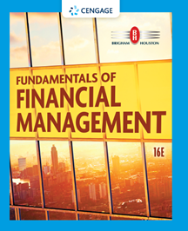
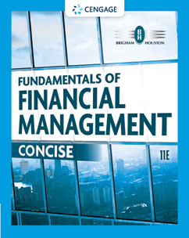
Chapter 9
Stocks and Their Valuation
Brigham & Houston, Fundamentals of Financial Management, Sixteenth Edition. © 2022 Cengage. All Rights Reserved. May not be scanned, copied or duplicated, or posted to a publicly accessible website, in whole or in part.

Slide 2
Overview
Features of Common Stock
Intrinsic Value and Stock Price
Determining Common Stock Values
Discounted Dividend Model
Corporate Valuation Model
Other Approaches
Preferred Stock

Slide 3
Facts About Common Stock
Represents ownership
Ownership implies control
Stockholders elect directors
Directors elect management
Management’s goal: Maximize the stock price

Slide 4
Intrinsic Value and Stock Price
Outside investors, corporate insiders, and analysts use a variety of approaches to estimate a stock’s intrinsic value
In equilibrium we assume that a stock’s price equals its intrinsic value.
Outsiders estimate intrinsic value to help determine which stocks are attractive to buy and/or sell.
Stocks with a price below (above) its intrinsic value are undervalued (overvalued).

Slide 5
Different Approaches for Estimating the Intrinsic Value of a Common Stock
Discounted dividend model
Corporate valuation model
Models based on market multiples

Slide 6
Discounted Dividend Model
Value of a stock is the present value of the future dividends expected to be generated by the stock.

Slide 7
Constant Growth Stock
A stock whose dividends are expected to grow forever at a constant rate, g.
D₁ = D₀(1 + g)¹
D₂ = D₀(1 + g)²
D_{t} = D₀(1 + g)^{t}
If g is constant, the discounted dividend formula converges to:

Slide 8
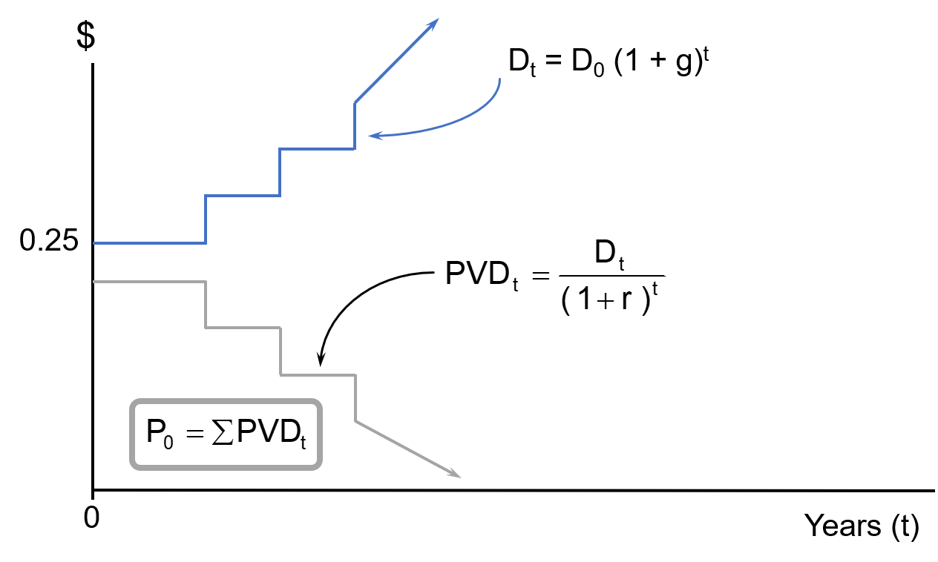
Future Dividends and Their Present Values

Slide 9
What happens if g > r_{s}?
If g > r_{s}, the constant growth formula leads to a negative stock price, which does not make sense.
The constant growth model can be used only if:
r_{s} > g
g is expected to be constant forever.

Slide 10
Use the SML to Calculate the Required
Rate of Return (r_{s})
If r_{RF} = 3%, r_{M} = 8%, and b = 1.2, what is the required rate of return on the firm’s stock?
r_{s} = r_{RF} + (r_{M} – r_{RF})b
= 3% + (8% – 3%)1.2
= 9%

Slide 11
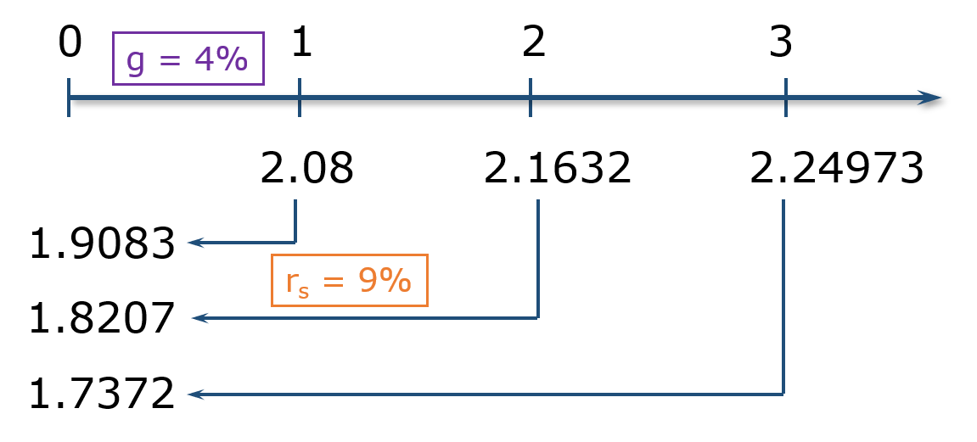
Find the Expected Dividend Stream for the Next 3 Years and Their PVs
D₀ = $2 and g is a constant 4%.

Slide 12
What is the stock’s intrinsic value?
Using the constant growth model:

Slide 13
What is the stock’s expected value, one year from now?
D₁ will have been paid out already. So, expected P₁ is the present value (as of Year 1) of D₂, D₃, D₄, etc.
Could also find expected P₁ as:

Slide 14
Find Expected Dividend Yield, Capital Gains Yield, and Total Return During First Year
Dividend yield
= D₁/P₀ = $2.08/$41.60 = 5.0%
Capital gains yield
= (P₁ – P₀)/P₀
= ($43.26 – $41.60)/$41.60 = 4.0%
Total return (r_{s})
= Dividend yield + Capital gains yield
= 5.0% + 4.0% = 9.0%

Slide 15
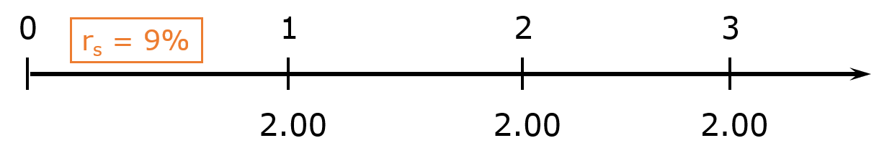
What would the expected price today be, if g = 0?
The dividend stream would be a perpetuity.

Slide 16
Supernormal Growth
What if g = 30% for 1 yr., 20% for 1 yr., and 10% for 1 yr. before achieving long-run growth of 4%?
Can no longer use just the constant growth model to find stock value.
However, the growth does become constant after 3 years.

Slide 17
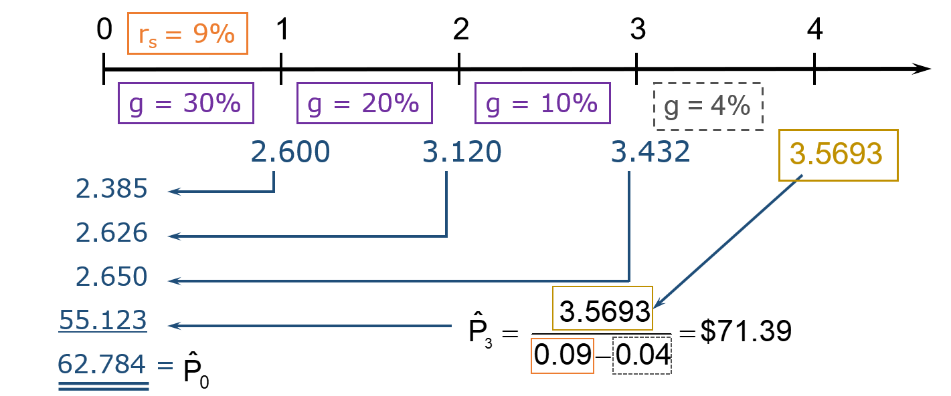
Valuing Common Stock with Nonconstant Growth
D₀ = $2.00.

Slide 18
Find Expected Dividend and Capital Gains Yields During the First and Fourth Years (1 of 2)
Dividend yield (first year)
= $2.60/$62.78 = 4.14%
Capital gains yield (first year)
= 9.00% – 4.14% = 4.86%
During nonconstant growth, dividend yield and capital gains yield are not constant, and capital gains yield ≠ g.
After t = 3, the stock has constant growth and dividend yield = 5%, while capital gains yield = 4%.

Slide 19
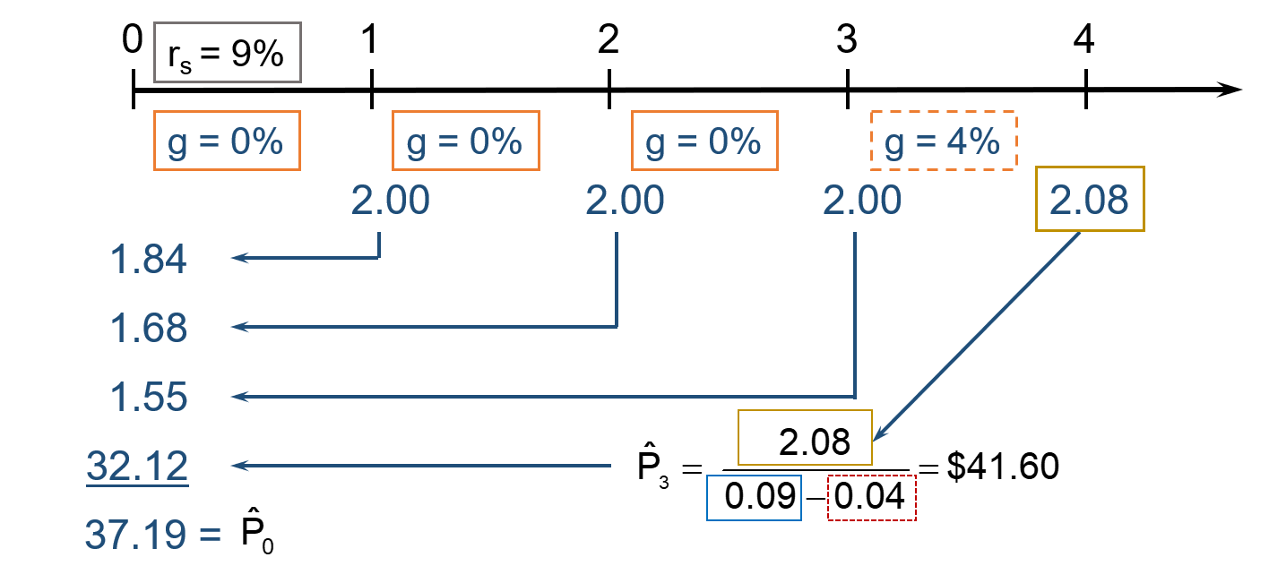
Nonconstant Growth: What if g = 0% for 3 years before long-run growth of 4%?
D₀ = $2.00.

Slide 20
Find Expected Dividend and Capital Gains Yields During the First and Fourth Years (2 of 2)
Dividend yield (first year)
= $2.00/$37.19 = 5.38%
Capital gains yield (first year)
= 9.00% – 5.38% = 3.62%
After t = 3, the stock has constant growth and dividend yield = 5%, while capital gains yield = 4%.

Slide 21
If the stock was expected to have negative growth (g = −4%), would anyone buy the stock, and what is its value?
Yes. Even though the dividends are declining, the stock is still producing cash flows and therefore has positive value.

Slide 22
Find Expected Annual Dividend and Capital Gains Yields
Capital gains yield
= g = –4.00%
Dividend yield
= 9.00% – (–4.00%) = 13.00%
Since the stock is experiencing constant growth, dividend yield and capital gains yield are constant. Dividend yield is sufficiently large (13%) to offset negative capital gains.

Slide 23
Corporate Valuation Model
Also called the free cash flow method. Suggests the value of the entire firm equals the present value of the firm’s free cash flows (which is the MV of its operations) plus the market value of its non-operating assets.
Remember, free cash flow is the firm’s after-tax operating income less the net capital investment.

Slide 24
Applying the Corporate Valuation Model
Find the market value (MV) of the firm’s operations, by finding the PV of the firm’s future FCFs.
Add the market value of the firm’s non-operating assets.
Subtract MV of firm’s debt and preferred stock to get MV of common stock.
Divide MV of common stock by the number of shares outstanding to get intrinsic stock price (value).

Slide 25
Issues Regarding the Corporate Valuation Model
Often preferred to the discounted dividend model, especially when considering number of firms that don’t pay dividends or when dividends are hard to forecast.
Similar to discounted dividend model, assumes at some point free cash flow will grow at a constant rate.
Horizon value (HV_{N}) represents value of firm’s operations at the point that growth becomes constant.

Slide 26
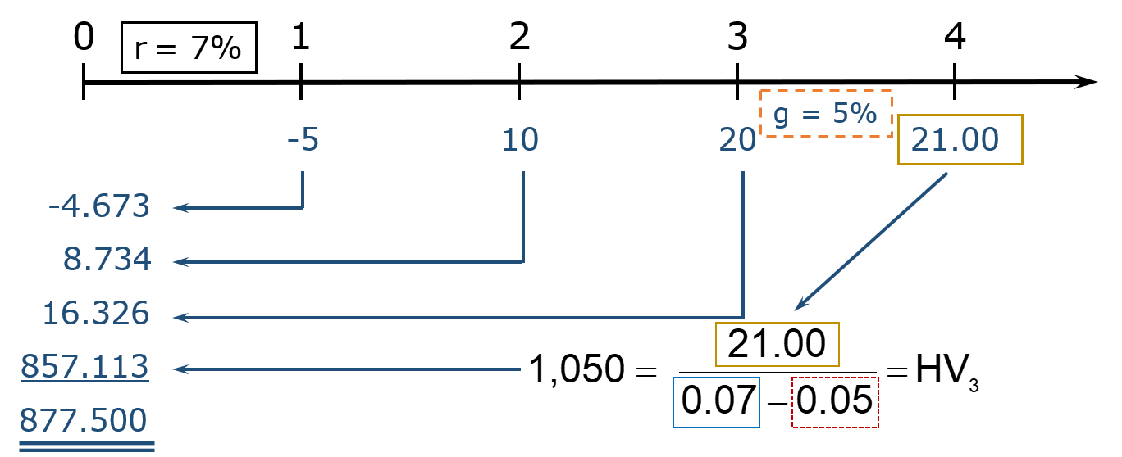
Use the Corporate Valuation Model to Find the Value of the Firm’s Operations
Given: Long-Run g_{FCF} = 5% and WACC = 7%

Slide 27
What is the firm’s intrinsic value per share?
The firm has $40 million total in debt and preferred stock, $5 million of non-operating assets, and 10 million shares of common stock.

Slide 28
Firm Multiples Method
Analysts often use the following multiples to value stocks.
P/E
P/CF
P/Sales
EXAMPLE: Based on comparable firms, estimate the appropriate P/E. Multiply this by expected earnings to back out an estimate of the stock price.
Enterprise-Based Multiples
EV/EBITDA

Slide 29
Preferred Stock
Hybrid security
Like bonds, preferred stockholders receive a fixed dividend that must be paid before dividends are paid to common stockholders.
However, companies can omit preferred dividend payments without fear of pushing the firm into bankruptcy.

Slide 30
If preferred stock with an annual dividend of $5 sells for $100, what is the preferred stock’s expected return?

